Slide 1
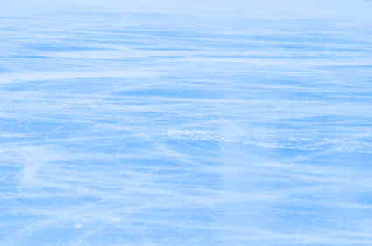

What on earth is in my skates?
By: Emma Yanko
And
Makaila Nichols-Degirolamo

Slide 2
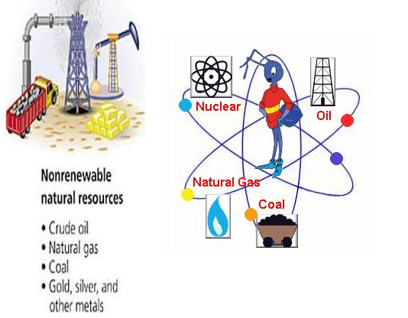
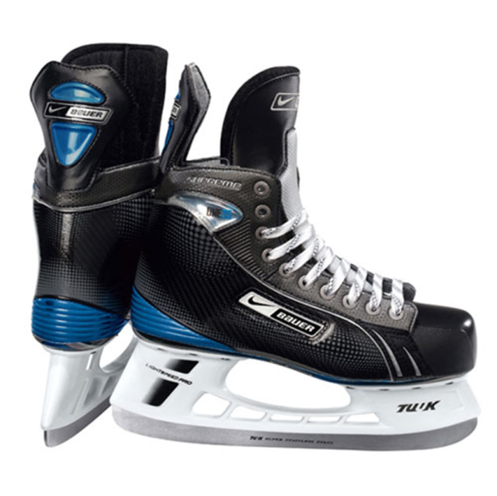
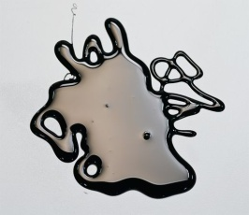
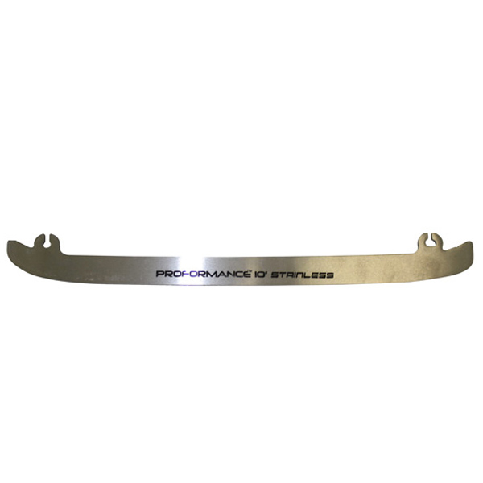
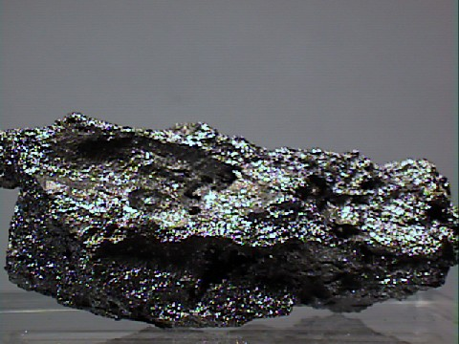
Where on earth does it come from?
Main parts of the skate:
Laces: The laces allow skaters to tighten or loosen skates to their specification. Laces are made of cotton or nylon.
Holders/ toe cap Holders and the toe cap are just injection molded plastics that are strong enough to take some abuse from pucks and support your weight.
Non-renewable resources:
Plastic
Plastic is made from oil and natural gas. It is used to create the outer boot of the skate, make the blade holder, and the toe cap. Top producers of oil: United States of America, Russia ,Saudi Arab, Iran and Iraq. Top producers of plastic: Saudi Arabia, Russia, U.S.A.
The blades: Most blades are made from a mixture of pure stainless steel and titanium. The amount of money you spend on your skate directly correlates to whether you get pure stainless or a mixture of metal by-products.
The upper portion of the boot: is made of three layers: nylon or aramid fabric outer layer, a middle layer that serves the purpose of absorbing energy, and a final layer that is waterproof to keep the player’s feet dry, warm, and comfortable. The toe and outer sole of the skate are made of rigid polymers to create a barrier of support and protection.
Stainless steel
Soles: Carbon based materials is used or will use what is called "graphite" to keep the sole hard as well as lightweight. An imitation of carbon fiber called, Texalium, is used on most mid-high end skates. The absolute best material currently used, however, is pure carbon fiber.
Stainless steel is an alloy that consists mostly of iron and has a carbon content between 0.2% and 2.1%. It is found in the skate blade. Top producers: The Netherlands, Spain, Germany, China, South Korea, Finland, USA, Japan, Taiwan, South Korea.
Titanium
Titanium is found in the skate blade. It is mined using strip mining. Titanium is quite expensive because it costs a lot of money to separate it from ore. Top Producers: China, Russia, Australia, Canada, India, Norway, South Africa, Ukraine, and the United States [Arkansas].
Did you know?
There are 145 steps to making hockey skates.

Slide 3
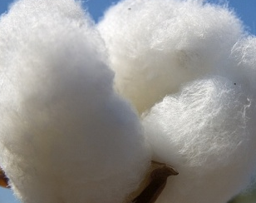
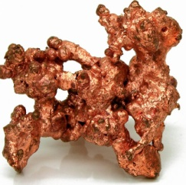
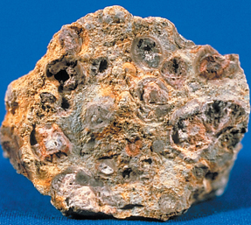
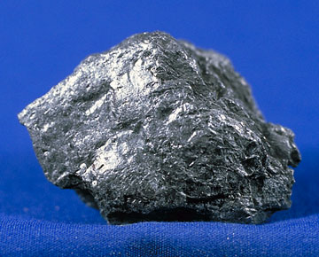
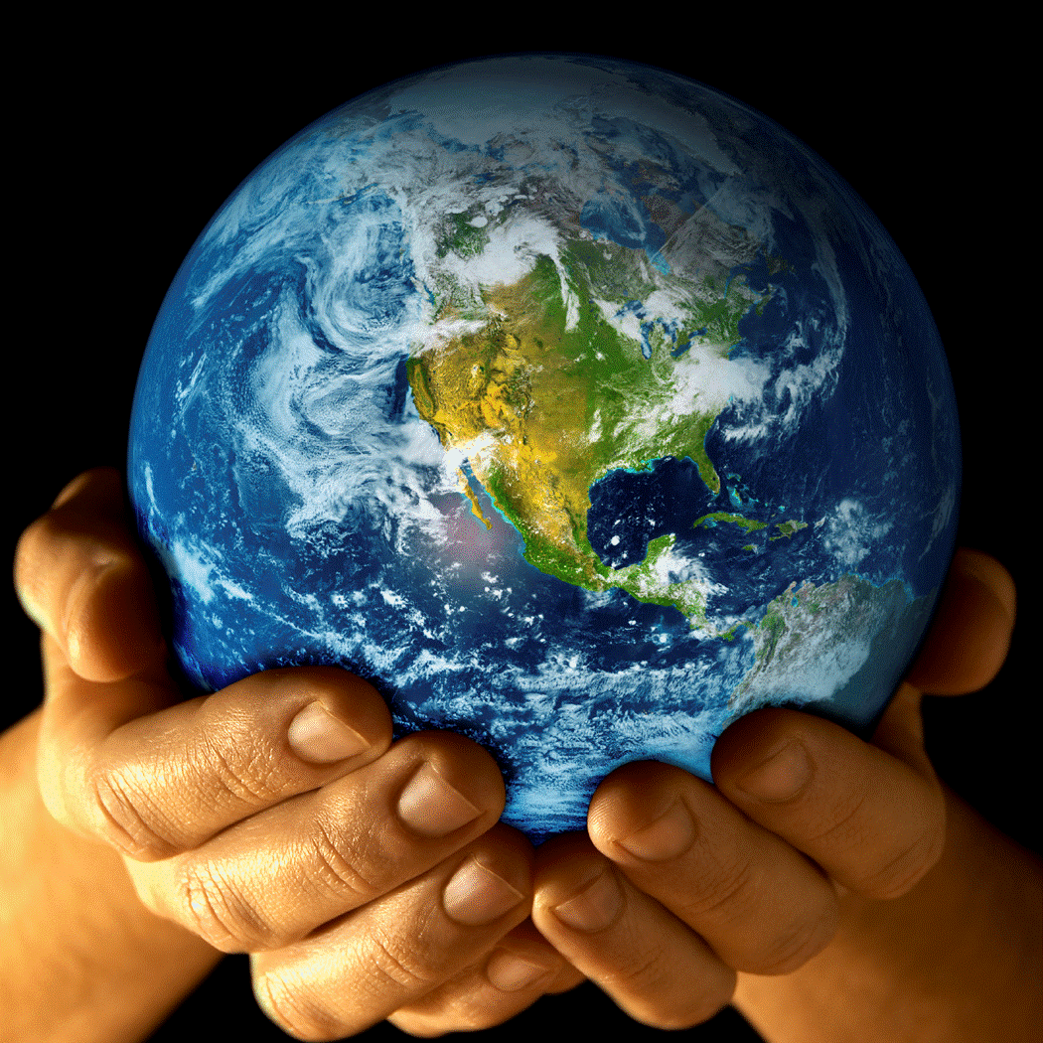
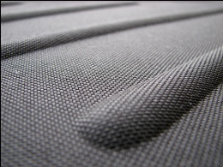

Renewable resources:
Non-renewable resources continued:
Cotton
Copper
Cotton is found in the skate laces. Top producers: U.S.A., China and India account for half of the world’s production. China is the biggest producer, but the United States is the leading exporter. Cotton is grown in some 80 countries around the world, mostly in warm climates.
Copper rivets are used in the production of the skate to hold the sole on to the rest of the boot. Top producers: of the copper ore mined in the United States, the majority is produced in three western states: Arizona, Utah, and New Mexico. Other major copper producing nations include Australia, Canada, Chile, China, Mexico, Russia, Peru, and Indonesia.
Aluminum
Why are non-renewable resources important?
Aluminum is used in the eyelets of the skate, which the laces are threaded through. It.is the most abundant metal element in the Earth’s crust. Bauxite is the main source of aluminum. Top producers: Russia, China, the United States, and Canada. More than 40 other countries also produce aluminum.
Non-renewable resources are natural resources that come out of the earth as liquids, gases, and solids. Natural resources, such as coal, oil, or natural gas, take millions of years to form naturally and therefore cannot be produced, re-grown, regenerated, or reused. Non-renewable resources are important, in some ways even more important than renewable resources. The main energy sources used by humans are non-renewable. Without non-renewable resources the world’s economy would be much smaller. Almost every country has a non-renewable resource to export.
Graphite
Graphite is found in the sole of the skate. It is very light and keeps the sole hard. Top producers: China is the most significant graphite-producing nation, providing nearly one-half of the United States’ annual graphite demand. Flake graphite is also imported to the United States from Brazil, Canada, and Madagascar. Lump graphite is imported from Sri Lanka.
Nylon
Ballistic-proof nylon is used to make the boot of the skate. Commonly knit nylon is used. Nylon is made from oil, and then made into a synthetic polymer. The top producers are: Asia and Japan.
Why did we choose to do hockey skates?
We chose to do hockey skates because I use them almost everyday of my life when I play hockey. I wanted to know what was in my skates since they are one of the most important items in my life. I had no idea how many non-renewable resources were used to make hockey skates. We have to try our best to conserve/ protect these resources if we want our future generations to have skates even more high tech then we do!
Texalium
Texalium is used on most high end skates to mimic the absolute best in the industry at being lightweight, and stiff. It can be found on the sole of the skate. The major ingredients are silica sand, limestone, and soda ash. These are all rocks which makes it a non-renewable resource. Top producer: United States (California).

Slide 4
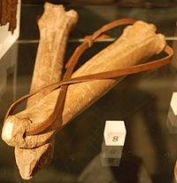
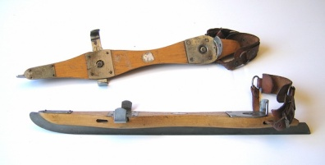
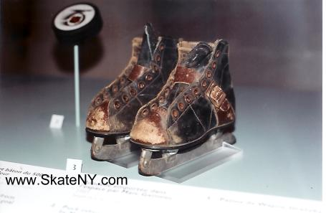
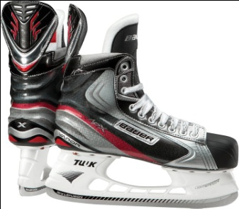
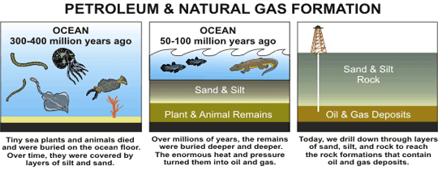
Hockey Skate Facts
The first ice skates were made from the leg bones of horses, oxen or deer, in about 3000 B.C. and were attached to feet with leather straps. A spiky pole was used to push the one’s self.
The next skates were made of iron in about 200 A.D.
In the 1500’s, they changed the runners of the skate to a narrow, double edged blade that allowed skaters to push and glide with their feet.
Some new hockey skates cost around 1000 dollars!
Canadian Resources Facts
Forests, plants, animals and fish are some of Canada's renewable resources.
Renewable resources can be replaced by nature.
Canada has 10% of the world's forests.
Minerals, metal, natural gas, and oil are some of Canada's nonrenewable resources.
They cannot be replaced by nature.
Hydroelectric power is sold to the United States.
Canada is one of the largest mining nations in the world.
Over 60 minerals and metals are produced in Canada.
Canada is the third largest diamond producing nation in the world.
Saskatchewan is the world's leader in the production of potash and uranium.

Slide 5

http://www.bing.com/images/search?q=oil+puddle&view=detail&id=F6EC8ABC3EC58C6721FCE217C394CDAC15B8249B&first=1&FORM=IDFRIR
http://www.ehow.com/list_6781566_materials-used-make-hockey-skates_.html
http://www.madehow.com/Volume-2/Ice-Skates.html
http://www.athleticscholarships.net/sports-equipment-ice-hockey.htm
http://en.wikipedia.org/wiki/Ice_skates
http://www.hhof.com/html/wo_blsSkates101.shtml
http://www.enotes.com/how-products-encyclopedia/ice-skates
http://www.lifeskate.com/skate/2008/02/145-steps-to-ma.html
http://www.theicehockeyblog.com/2009/11/buying-hockey-skatesmaterials.html
http://www.talktalk.co.uk/reference/encyclopaedia/hutchinson/m0023676.html
http://www.earthsciencescanada.com/where/#
http://www.galleries.com/minerals/elements/graphite/graphite.htm
http://en.wikipedia.org/wiki/Aramid
http://www.eoearth.org/article/Aluminum
http://www.cfbf.com/issues/NAFTA/docs/part3B.pdf
http://library.thinkquest.org/5443/wheregrown.html
http://library.thinkquest.org/05aug/00461/titanium.htm
http://www.ehow.com/list_6720060_top-suppliers-plastic.html
http://finmanac.blogspot.com/2009/04/top-10-stainless-steel-producers-in.html
http://en.wikipedia.org/wiki/Steel
http://www.tutorvista.com/biology/list-of-non-renewable-resources
http://en.wikipedia.org/wiki/File:NatCopper.jpg
http://www.mii.org/Minerals/photoal.html
http://www.myefficientplanet.com/tag/why-are-non-renewable-resources-important/
http://www.saskschools.ca/~gregory/canada/facts/can.html
http://www.eia.doe.gov/kids/energy.cfm?page=nonrenewable_home-basics
http://icicp.blogspot.com/2010/04/healing-earth-with-service.html
Bibliography:
Thank you to all these sites, without them I wouldn’t have been able to do this!
To hear someone skating on hockey skates click here

