Slide 1
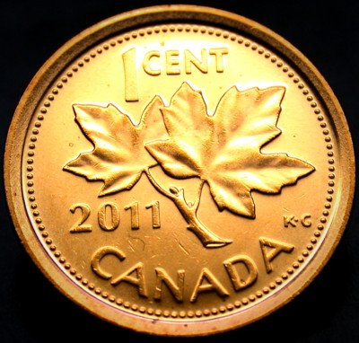
Pennies
Copper in your pocket
Click space bar for effects and turn up sound

Slide 2
Open your wallet
What do you see inside? Chances are you will see a lot of pennies!
Have you ever wondered where they come from and what they are made of?
Let me take you on a learning journey...

Slide 3
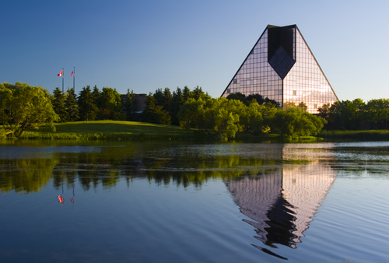
Big bucks in Winnipeg
Pennies are produced at the Royal Canadian Mint production facility in Winnipeg, Manitoba.
In 2009, 455 680 000 pennies were produced for circulation.

Slide 4
Stampeding coins
Pennies begin their life as a roll of core steel fed into a punch press that churns out blank coins
These blanks are refined by removing rough edges
Blanks are next electro-plated with mixture of nickel and copper
After plating, the blanks are dried, polished and inspected before proceeding to the coining press where they are stamped

Slide 5
A century of pennies ...
(plus a few)
1908 -1996
1997-2011
Weight:
5.67 g - 2.5 g
Diameter:
25.4 mm - 19.1 mm
Composition:
95.5 % - 98 % Copper
1.75 % - 3 % Tin
1.5 % - 0.25 % Zinc
Weight :
2.25 g –2.35 g
Diameter:
19.05 mm
Composition:
98.4 % Zinc + 1.6 % Copper (1997-1999)
94 % Steel + 1.5 % Nickel + 4.5 % Copper (2000 -)

Slide 6
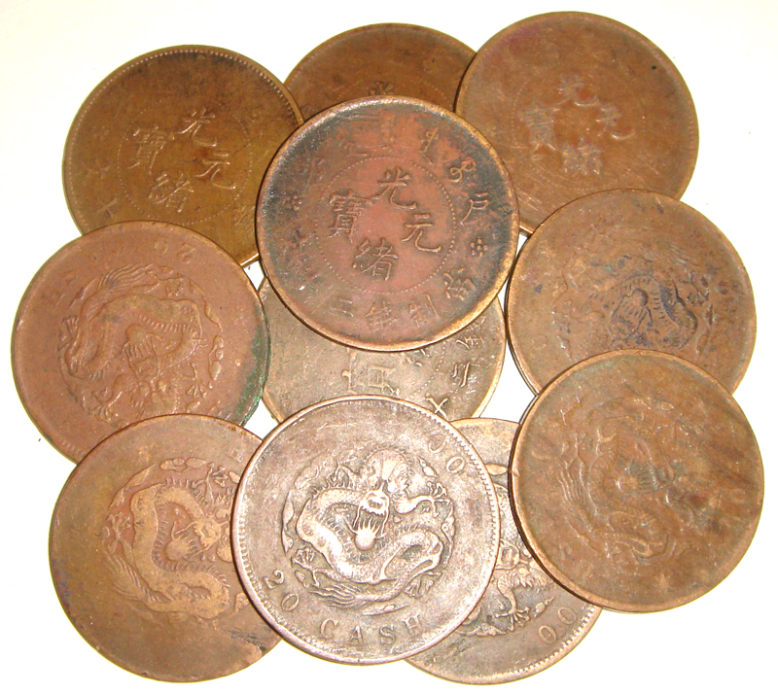
Copper in currency : it goes back a few years
The use of coinage dates back to ancient times in Mesopotamia when gold, silver and copper or bronze had a corresponding value and weight in commodities such as barley.
Copper continues to be used in coin manufacturing around the world today because of it’s resistance to corrosion and long life span.

Slide 7
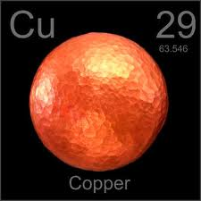
It’s elementary, my dear
Copper is a chemical element with the symbol Cu and atomic number 29.
Copper is a naturally occurring metal. Pure copper is found rarely. It is more commonly found in such minerals as azurite, malachite and bornite and in sulfides as in chalcopyrite, coveline, chalcosine, or oxides like cuprite.
Copper has uses such as currency, jewellery, electric wiring, pipes, and cooking utensils and pots.

Slide 8
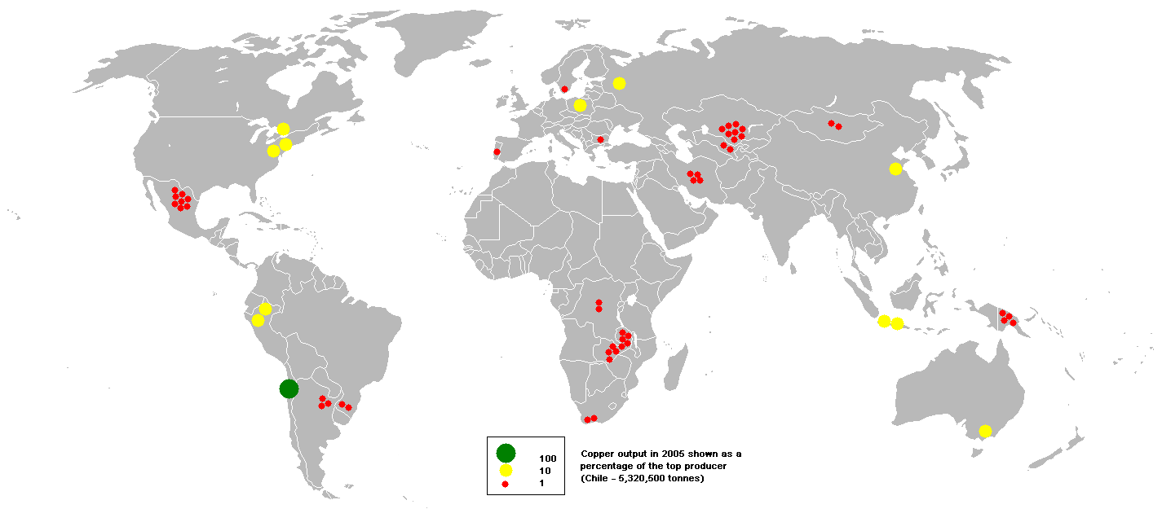
And where in the world do we find copper?
So now we know that pennies used to be made of 98 % copper.
But where in the world does it come from?
( map of world wide copper production 2005)

Slide 9
Bibliography
http://www.mint.ca
http://seeker401.wordpress.com/2010/04/11/royal-canadian-mint-in-winnipeg/
http://en.wikipedia.org/wiki/Copper
http://www.csa.com/discoveryguides/copper/overview.php
http://en.wikipedia.org/wiki/Penny
http://en.wikipedia.org/wiki/History_of_money

