Slide 1
What’s In a Stapler?
Samantha Kieffer

Slide 2
Hi, my name is Point. Have you ever wondered what’s in a stapler? Follow me to learn all about the wonder of staplers...

Slide 3
rubber
plastic
The main components of a stapler include:
plastic for the outer shell
a rubber grip
a zinc coating over the main parts of the stapler, which are made of steel
zinc coating
steel

Slide 4
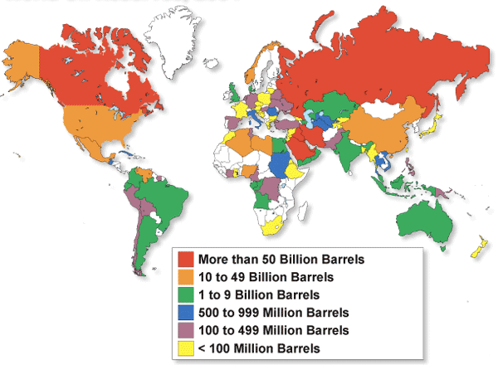
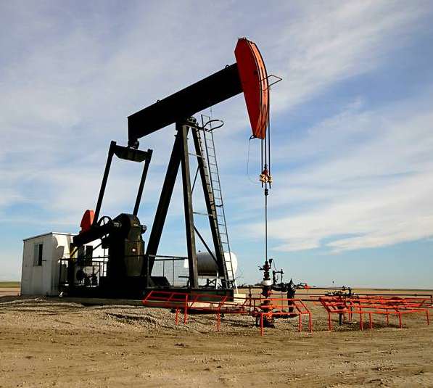
Plastic is made from oil. The oil is drilled from the Earth’s crust using an oil drill which pumps oil from sedimentary rock. The oil is heated and then separated into parts. Plastic is made from one of these parts. Canada is one of more than 75 countries that drill for raw oil.

Slide 5
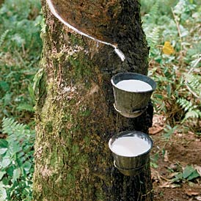
rubber
Rubber is made from petroleum and oil. Petroleum contains many carbon molecules. These are then chemically altered so they become molecules called dienes. Dienes are re-altered so they form a long chain of polymers and polymers are the finished rubber.

Slide 6
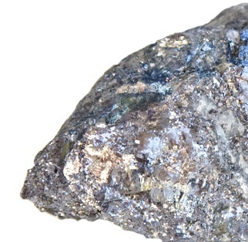
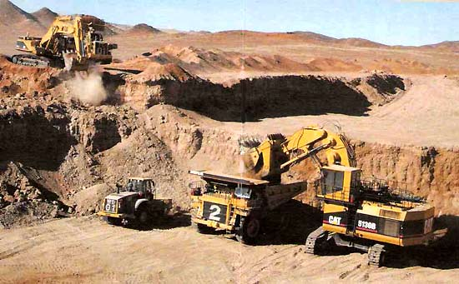
Zinc is the fourth most common metal used in everyday items. It is mined from zinc ore, such as sulfidic ore deposits. After extraction, the zinc is separated from the other metals that it is found with, such as copper and lead. China, Canada, and Peru are the top zinc producers. Did you know that the world’s largest zinc mine is in NB, near Bathurst? This mine contains zinc and lead.

Slide 7
Iron ore is used to make steel. Iron ore is loaded into a blast furnace, along with pure carbon. The iron comes out from the blast furnace infused with carbon. The iron is then transferred to an oxygen furnace, where it’s combined with steel scrap and exposed to a jet of pure oxygen. The oxygen combines with the carbon to create carbon monoxide and carbon dioxide. These fumes are pulled from the oxygen furnace, but the purified molten iron - now called carbon steel - is left behind. The transformation takes less than an hour.

Slide 8
So, with rubber, zinc, steel, and plastic, you can make a wonderful contraption called “Stapler.” All of the pieces are fitted together.

Slide 9
And Finally...
A STAPLER IS COMPLETE!

Slide 10
Credits
http://www.schools.pinellas.k12.fl.us/gallery/cartoon/stapler.gif (stapler)
http://www.rrc.state.tx.us/commissioners/williams/energy/images/ 2919953WORLDOILRESERVES.gif
http://www.canada-maps.org/alberta/images/oil-pump-jack.jpg
http://edu.glogster.com/media/5/19/48/38/19483829.jpg
http://www.ptable.com/Images/periodic%20table.png
http://2.bp.blogspot.com/_TlkJLGx5ano/TRY8xO0hXvI/AAAAAAAAAfI/ gCxEgisCgCo/s1600/red_stage_curtains.jpg
http://www.howtodothings.com/
http://www.the-rubber-band.com/images/history_tappingbark.jpg
www.earthsciences.com
Stapler Pictures: My Own…S. Kieffer

