Slide 1
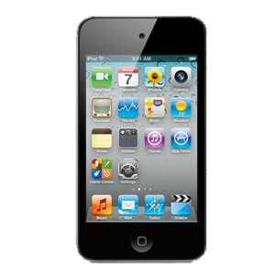
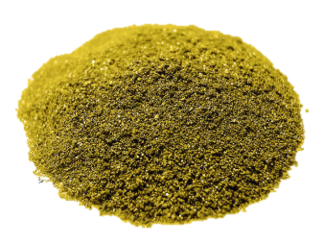
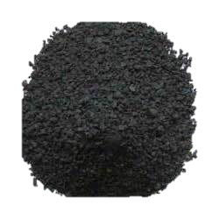
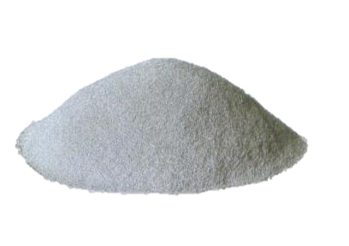
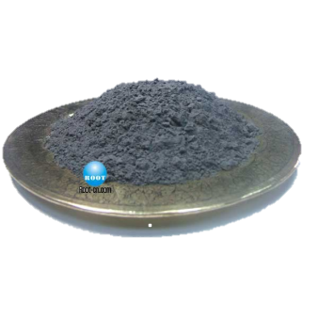
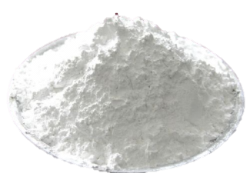
Introducing
The iResources
Gold Powder
Plastic Polymer
Aluminum Powder
Lithium-Ion
Silica Sand
“You didn’t think it was possible to make an iPod almost completely out of Non-Renewables, but we did, and it’s great!”

Slide 2
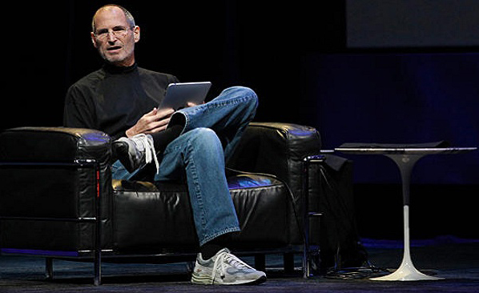
Today we are introducing something very special. We are unveiling one of the first iPods to be made almost completely out of non-renewable resources. It’s called the iResources. But what is a non-renewable resource? It is a limited substance that occurs naturally in the Earth and is removed faster than it can be replenished.

Slide 3
You’re probably wondering how the iResources has made this possible but follow along and we’ll show you what on Earth is in this thing and where on Earth it comes from.

Slide 4
For this demo, I have taken apart the 4th generation of the iPod Touch

Slide 5
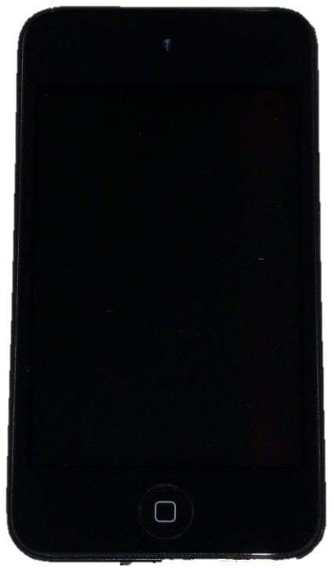
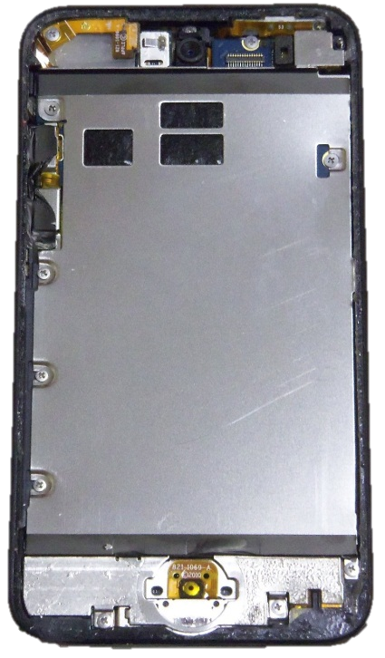
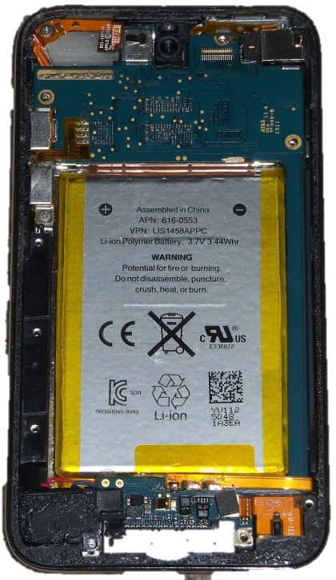
The Parts of An iResources
Glass Touch Screen (Silica)
Aluminum
Cover
(Aluminum)
Battery
(Lithium
Polymer)
Home Button
Flex Cable
Double Sided Scotch Tape (Acrylic Polymer)
Plastic Home Button
(Polymer)
Plastic
Frame
(Polymer)

Slide 6
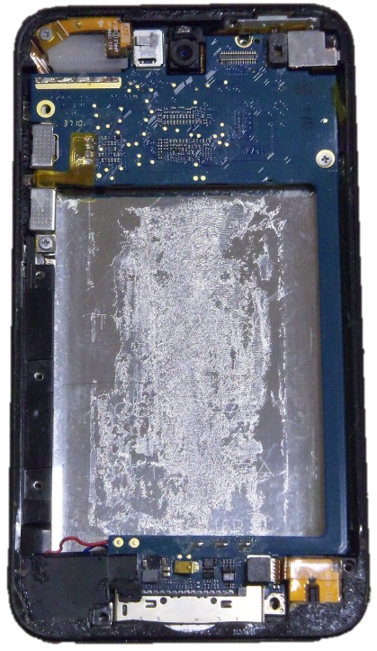
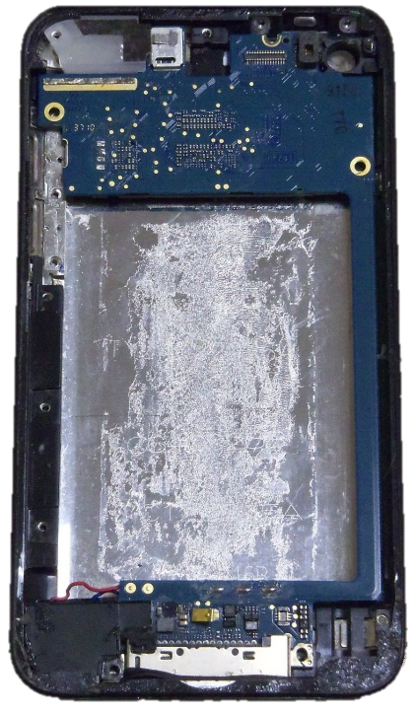
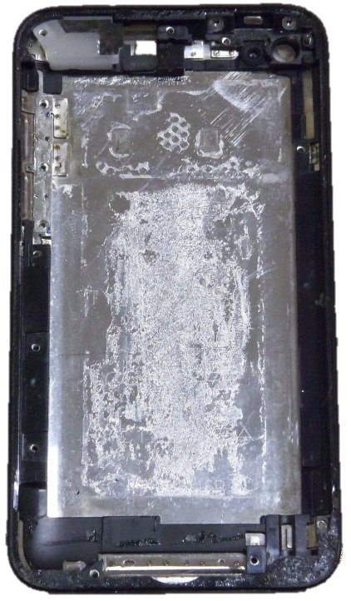
The Parts of An iResources
Cameras
(Polymer, Silica)
Plastic
Lens
Cover
(Polymer)
Logic
Board
(Tin-Lead Alloy, Copper, Gold, Silicone)
WiFi and Volume Flex Cables
(Polymer, Gold)
Gold Plated
Leads
Back Casing
(Polymer)
Headphone
Flex Cable
(Gold, Polymer)
Aluminum
Housing
(Aluminum)

Slide 7
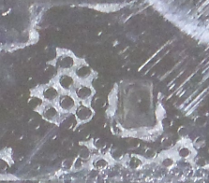
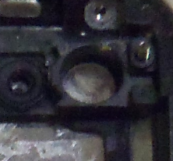
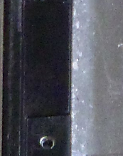
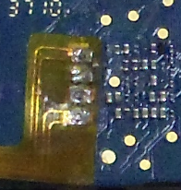
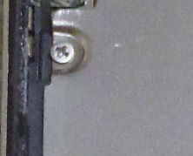
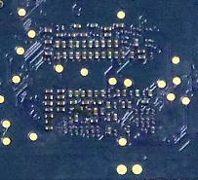
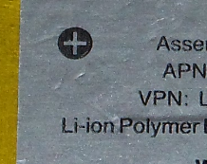
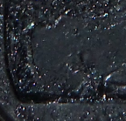
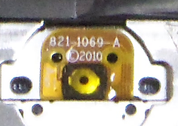
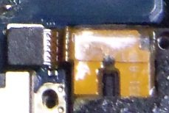
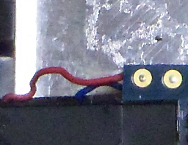
As you can see here, the iResources is made of almost completely non-renewable resources. All these resources are necessary for it to function but we are going to show you just a few very important ones.
Resource | Where is it Found in The iPod?
Plastic | Cables, Frame, Home Button, Camera
Gold | Logic Board (PCB), Flex Cables
Glass | Touch Screen, LCD, Camera Lenses
Silicon | Logic Board (ICs), LCD
Copper | Logic Board
Aluminum | Back Housing, LCD Cover
Lithium-ion | Battery

Slide 8
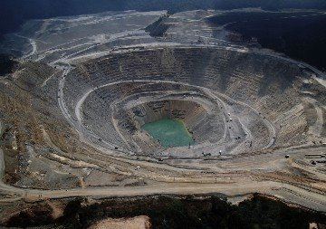
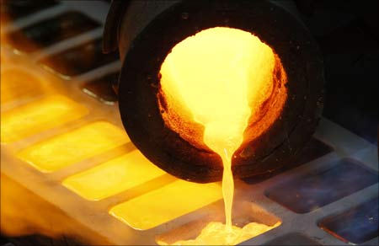
Gold!
Gold is a very important resource in the iResources. Gold is used on the leads of components like the CPU because gold is an excellent conductor which allows for faster processing and overall, a faster device!
Gold is mined in open pit mines all over the word and is recovered in the form of nuggets, grains and flakes. After the gold is mined, it is shipped to a factory to get smelted. Smelting is a process of melting the gold and removing any impurities which leaves just the pure gold.

Slide 9
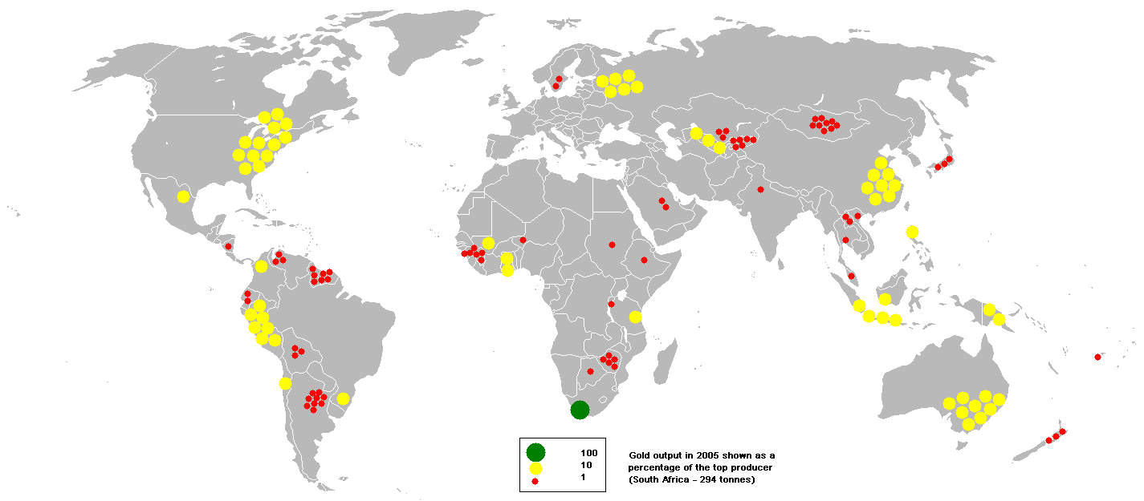
Gold is found in many countries around the world but the largest producer is South Africa leading in at 393.2 Tonnes in 2005. Some other large producers include Australia, the U.S.A. and China. Gold is also found in Canada with 118.5 Tonnes produced in 2005
South Africa
393.2 Tonnes
Australia
262.9
Tonnes
U.S.A.
261.7 Tonnes
China
224.1 Tonnes

Slide 10
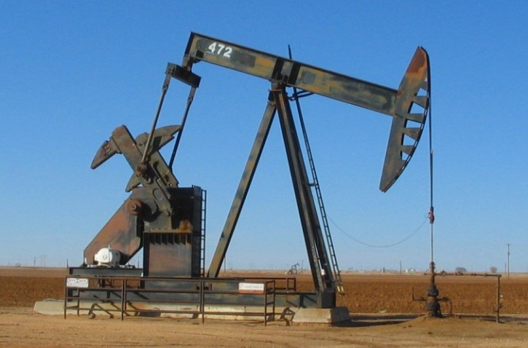
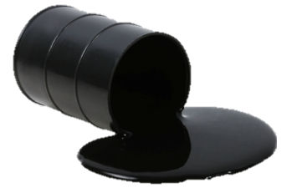
Plastic!
Plastic is another important part of the iResources. Plastic is found in parts like the frame, LCD, buttons and cables. Plastic itself cannot be mined, it instead comes from crude oil and natural gas which is drilled from the Earth. Oil drills like the one on the left are used to drill for oil.
Plastic is essentially a polymer which is made up of a chain of monomers and a monomer is simply a molecule that is taken out of oil.

Slide 11
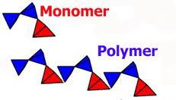
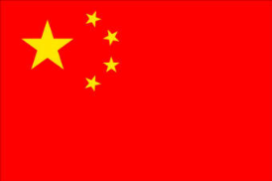
In order for the monomers to be transformed into a polymer, they first have to undergo a processes called “Thermosetting”. It is a process of heating the monomers to high temperatures and the cooling them down in a mold. This process connects the monomers into a long chain to make a polymer.
The largest producers of oil include, Russia, Saudi Arabia, United States and China. Canada is also a large producer of oil with most of our oil coming from Alberta!
10.124 Million Barrels Per Day
10.121 Million Barrels Per Day
9.6 Million Barrels Per Day
4.27 Million Barrels Per Day

Slide 12
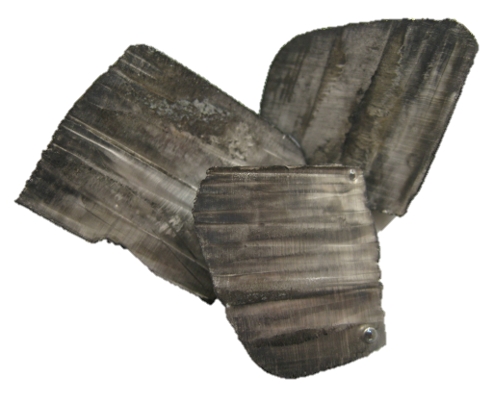
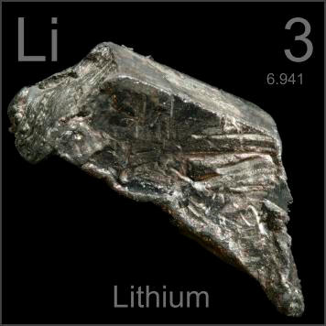
Lithium!
Lithium is another very important resource that is found in the iResources. It is found in the lithium polymer battery. Without this precious metal, you wouldn’t have such good battery life or even any battery life at all for that matter.
Lithium is the lightest solid element found on Earth
Lithium’s atomic number is 3
Lithium’s atomic mass is 6.941
Lithium is so reactive that it will ignite if exposed to water vapour!

Slide 13
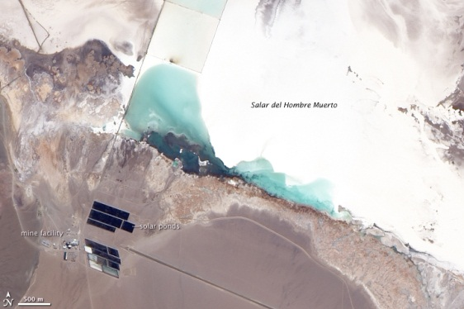
Lithium is found in places like mineral springs, brine pools and brine deposits. However, since lithium is so reactive, it is never found in it’s pure form. Instead it is usually found in igneous rock with other elements forming compounds. A process called electrolysis is used in order to separate lithium from other elements. From there, the lithium can be used to make batteries.
Lithium can be found all over the world but the largest producers are Chile, Australia, Argentina and China. There is also a small amount of lithium mined in Canada which mainly comes from Quebec.
12,600
Tonnes in 2011
9,260
Tonnes in 2011
5,200
Tonnes in 2011
3,200
Tonnes in 2011

Slide 14
Hopefully you have caught on and found out that we aren’t actually unveiling a new product. Instead we are just showing you what is in an iPod Touch. The iPod Touch was released in September 2007 and over 60 million have been sold! That is a lot of non renewable resources used! It is important to know what’s in your stuff and where it came from because if we aren’t able to conserve our resources, we may be back to our old ways.

Slide 15
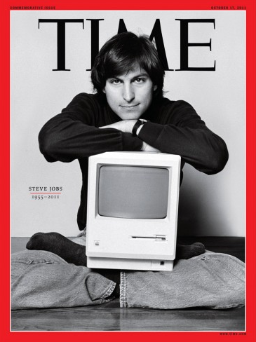
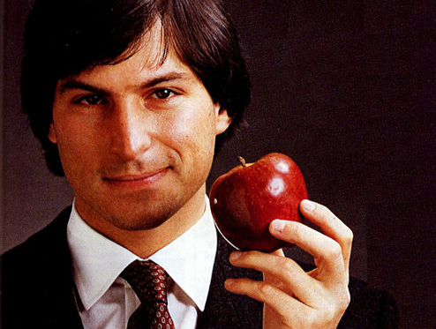
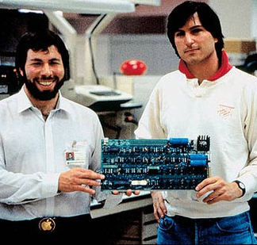
This Presentation Was Made in Memory of:
Steve Jobs 1955-2011

Slide 16
Bibliography
http://www.yesmag.ca/Questions/tape.html
http://en.wikipedia.org/wiki/Lithium-ion_polymer_battery http://en.wikipedia.org/wiki/Printed_circuit_board
http://www.calculus-tac.co.za/images/gold-powder.jpg
http://www.quartz.saint-gobain.com/uploadedImages/SGquartz/Products_and_Services/Families/silica%20powder.png
http://web.tradekorea.com/upload_file2/product/650/P00271650/cbe9caa5_2e3d0a23_b147_4dee_b470_8ab7ce7db0e6.jpg
http://2.imimg.com/data2/BX/BC/MY-/42-250x250.jpg
http://image.made-in-china.com/2f0j00TMBtHnlghkUw/Pure-Aluminum-Powder.jpg
http://www.root-cn.com/images/product/Tourmaline-Powder-400-500mesh.jpg
http://www.youtube.com/watch?v=QFJ3_FyrZpc
http://en.wikipedia.org/wiki/Plastic
http://www.bestbuy.ca/multimedia/Products/300x300/101/10153/10153660.jpg http://www.youtube.com/watch?v=Oq8-H7-yRRI
http://en.wikipedia.org/wiki/Gold
http://helios.gsfc.nasa.gov/nucleo.html
http://upload.wikimedia.org/wikipedia/commons/3/32/Gold_%28mined%292.png
http://ryankett.hubpages.com/hub/largest-gold-producer
http://en.wikipedia.org/wiki/Silicone

Slide 17
http://bp3.blogger.com/_4HdwwI3Z_mM/SCz0YBgdiQI/AAAAAAAAADM/qR8ttij0v5c/s1600-h/newmont_pit%5B1%5D.jpg
http://2.bp.blogspot.com/-jfcKsvaZT10/TtaEGokIbPI/AAAAAAAAAgU/8CXF7fC9CCg/s1600/gold+smelter.jpg
http://naterosenberg.files.wordpress.com/2010/04/ipad_steve_jobs.jpg
http://en.wikipedia.org/wiki/Smelting
http://www.benzinga.com/files/steve_jobs_sitting_main.jpg
http://www.wisegeek.com/how-is-plastic-made.htm
http://thomko.squarespace.com/how-plastic-is-made/
http://www.petroleum.co.uk/images/petroleum.jpg
http://financialedge.investopedia.com/financial-edge/0311/Top-5-Oil-Producing-Countries-In-2011.aspx#axzz1mz4iDwMb
http://www.enchantedlearning.com/asia/saudiarabia/flag/Flagbig.GIF
http://flagspot.net/images/r/ru.gif
http://wwp.greenwichmeantime.com/time-zone/asia/china/images/china-flag.jpg
http://www.crwflags.com/fotw/images/u/us.gif
http://www.batteryeducation.com/2006/04/what_is_the_dif.html
http://www.wisegeek.com/what-is-lithium.htm

Slide 18
http://0.tqn.com/d/chemistry/1/0/W/9/1/lithiummetal.jpg
http://periodictable.com/Samples/003.3/s9s.JPG
http://en.wikipedia.org/wiki/Lithium
http://en.wikipedia.org/wiki/File:Lithium_mine,_Salar_del_Hombre_Muerto,_Argentina.jpg
http://en.wikipedia.org/wiki/File:Flag_of_Chile.svg
http://en.wikipedia.org/wiki/File:Flag_of_Australia.svg
http://en.wikipedia.org/wiki/File:Flag_of_Argentina.svg
http://images.clipartof.com/small/437602-Royalty-Free-RF-Clip-Art-Illustration-Of-A-Prehistoric-Man-Chiseling-A-Tablet.jpg
http://oilrigdrillings.com/2011/12/26/oil-drill/
http://en.wikipedia.org/wiki/Steve_Jobs
http://edudemic.com/wp-content/uploads/2011/10/steve-jobs-apple.jpg
http://www.smashiphone.net/wp-content/uploads/6a00e55225079e8834014e609ad6df970c-pi.jpg
http://upload.wikimedia.org/wikipedia/commons/b/b9/Steve_Jobs_Headshot_2010-CROP.jpg
http://static8.businessinsider.com/image/4e8df0bbecad048d51000031/steve-jobs-time-cover.jpg

