Slide 1

What’s in a Pencil?
Where Contest 2012
By: Hailey Zanth

Slide 2
My name is Peter Pencil, and there isn’t anything in the whole entire world that excites me more than a pencil does. There’s just something about the sharp point of a HB#2 pencil that makes my heart race. Ever since I was a little boy, I’ve wanted to learn everything there is to possibly know about pencils. Maybe some of you would like to know too! Today is your lucky day. I have put together this presentation to tell you all there is to know about that pencil in your hand.
Let’s get to the point!

Slide 3

What are the parts of a pencil?
I’m glad you asked! Pencils are made of 4 main parts: the lead; the wooden body; the ferrule and the eraser. Each is composed of different renewable and non-renewable materials.
Eraser: Rubber, Pumice and Sulfur Mixture
Wood Body:
Incense Cedar
Ferrule:
Aluminum
Lead: Graphite
and Clay Mixture

Slide 4
Wait! What’s the difference between a
renewable and non-renewable resource?
I knew I was forgetting something!
A renewable resource is simply a naturally occurring resource that can be used continuously and will replenish itself over time (usually within a human lifespan), like wood, water or sunlight.
A non-renewable resource is a resource that exists in a fixed amount and is usually used up before it can be replenished, which takes hundreds of years, like coal and oil.

Slide 5
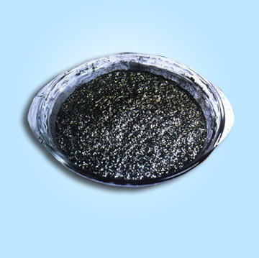
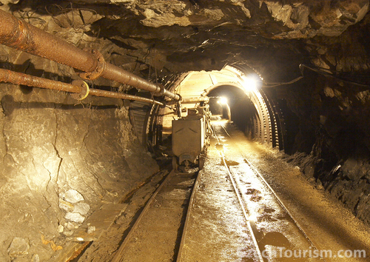
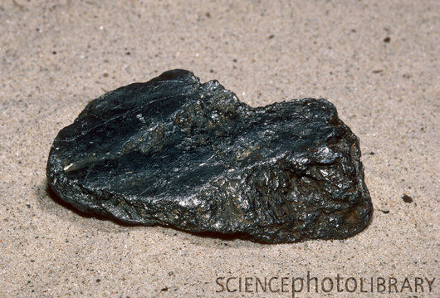
Materials in a Pencil - Lead
Lead is made of a GRAPHITE and CLAY mixture.
Graphite is a soft mineral found in metamorphic rocks. It is one of the two crystal forms of Carbon (C) and is formed under the intense heat and pressure of coal and limestones combining to become metamorphic rocks. Graphite can be created artificially, but natural graphite is cheaper. Graphite is mined by underground mining and quarrying on the surface of the earth, depending on how deep in the crust the graphite is found.
During the processing process, clay is added to the graphite as a bonding agent, in order for the graphite to stick together.

Slide 6

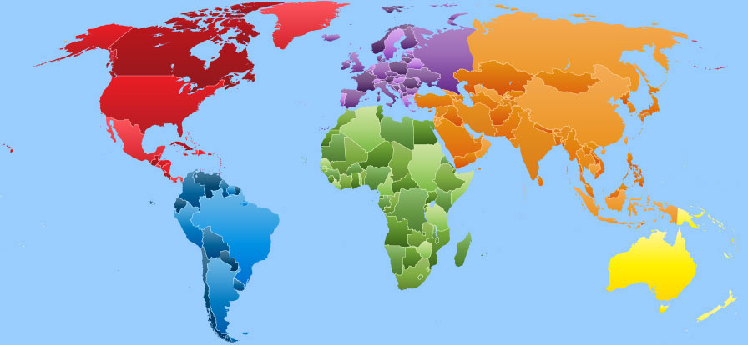
Where does graphite come from?
5. CANADA
(25 000 Tonnes)
4. NORTH KOREA
(30 000 Tonnes)
CHINA (800 000 Tonnes)
2. INDIA
(130 000 Tonnes)
3. BRAZIL
(76 000 Tonnes)
**Tonnes Produced Annually

Slide 7
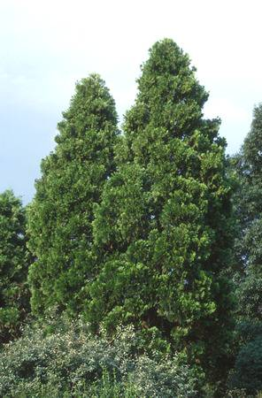
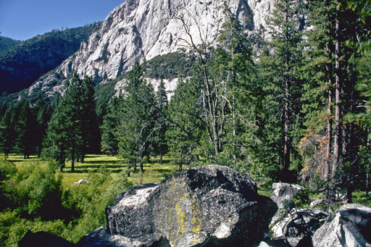
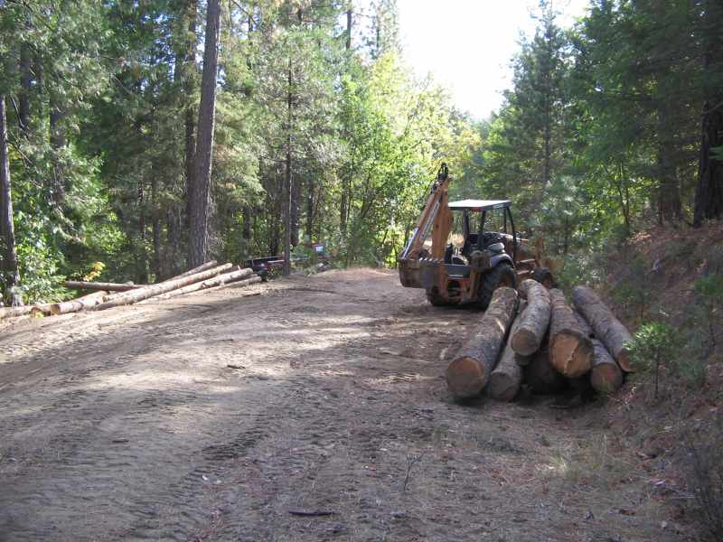
Materials in a Pencil - Wood
The main type of wood used for pencils is called INCENSE CEDAR. This type of tree grows mainly in southern Oregon and the Sierra-Nevada mountains in California. This particular tree is used for pencils because it can tolerate extreme temperatures and conditions without breaking. Also, it’s physical makeup allows it to be finely crafted and has an incredibly smooth surface and excellent “sharpenability” when finished. Incense Cedar trees replenish quickly and in any spot in the forest it came from.

Slide 8
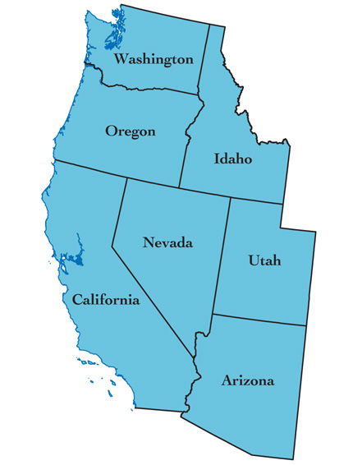
Where do Incense Cedar trees
grow?
SOUTHERN
OREGON
NORTHERN
CALIFORNIA

Slide 9
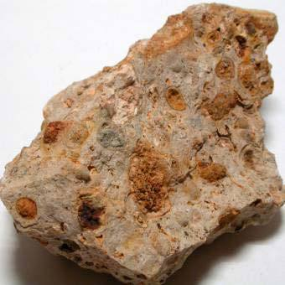
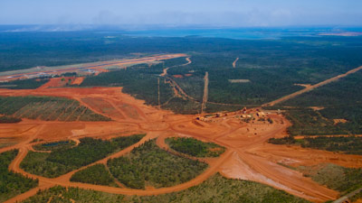
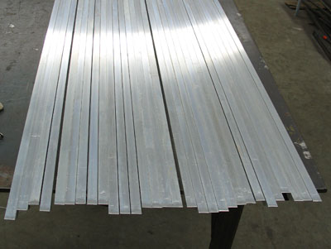
Materials in a Pencil - Ferrule
The ferrule (the little silver part that holds the eraser) is made of ALUMINUM.
Aluminum is an abundant metallic metal that has been around for centuries. It is extremely malleable and can be pounded into thin sheets easily. Aluminum can conduct electricity easily and is not magnetic and is never found free in nature. Aluminum is commonly found in BAUXITE ORE and is extracted by using the Hall-Heroult method of smelting. Bauxite Ore forms when silica is washed away from rocks containing aluminum. The Bauxite Ore used to create Aluminum is mined in open-pit mines, and is then taken to a plant to be processed into Aluminum.

Slide 10
Where does bauxite ore come from?
5. RUSSIA
(500 000 Tonnes)
UNITED STATES
(4 260 000Tonnes)
3. GREECE
(1 100 000 Tonnes)
4. TURKEY
(600 000 Tonnes)
2. CHINA
(3 200 000 Tonnes)
**Tonnes Produced Annually

Slide 11
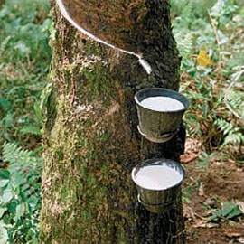
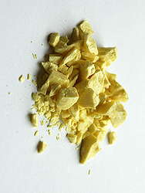
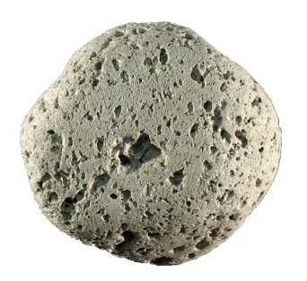
Materials in a Pencil - Eraser
The eraser is made of a RUBBER, SULFUR and PUMICE mixture, along with various other ingredients.
Rubber is produced by collecting latex from various species of plants. This process is done by cutting a slit into the trunk of a tree (usually Hervea Brasilienesis), letting the latex sap drip and collect in a bucket. This is called ‘tapping’ the tree. The latex is then mixed with other chemicals and is heated to produce the rubber.
Sulfur is a non-metallic element that can be found freely in nature. It is added to erasers because it allows the rubber to become stronger and more heat resistant.
Pumice is a volcanic rock filled with air bubbles that is so light it will float on water. It is formed when lava containing a lot of gas and water is pushed out of the volcano. As it cools, the gas and water evaporate, leaving tiny air pockets in it’s place. Pumice is added to erasers because it makes them more abrasive and allows the words that are being erased to rub off easier.

Slide 12
Where is rubber produced?
5. VIETNAM
(659 600 Tonnes)
THAILAND
(3 166 910 Tonnes)
4. INDIA
(819 000 Tonnes)
3. MALAYSIA
(1 072 400 Tonnes)
2. INDONESIA
(2 921 872 Tonnes)
**Tonnes Produced Annually

Slide 13
Where does sulfur come from?
3. RUSSIA
(7 100 000 Tonnes)
4. CANADA
(7 000 000 Tonnes)
UNITED STATES
(9 900 000 Tonnes)
5. GERMANY
(3 800 000 Tonnes)
2. CHINA
(9 400 000 Tonnes)
**Tonnes Produced Annually

Slide 14
Where does pumice come from?
3. GREECE
5. UNITED STATES
1. ITALY
4. TURKEY
2. CHILE

Slide 15
AND THERE YOU HAVE IT!
A FINISHED PENCIL!
Once all the materials are gathered and produced, they are taken to a production plant where the pencil is assembled one step at a time, and is then distributed all around the world!
I hope that after all this, many more of you appreciate the beauty of that simple little pencil a little more. I know I do!

Slide 16
Pencil Fun Facts!
The more graphite in the lead, the darker it will be.
The word ‘pencil’ comes from the Latin word penocillus.
One pencil is enough to draw a line that is 70 miles long.
Most pencils sold in Europe do not have erasers on the end.
One pencil can write approximately 45 000 words.
Enough pencils are made annually to circle the globe 42 times.

Slide 17
Bibliography
Thank you to the following sources for making this project possible:
http://www.pencilpages.com/misc/faq.htm
http://library.thinkquest.org/05aug/00461/graphite.htm
http://science.howstuffworks.com/aluminum2.htm
http://www.pencils.net/facts.cfmhttp://pubs.acs.org/cen/whatstuff/stuff/7942sci4.html
http://www.mii.org/pdfs/every/pencil.pdf
http://geology.about.com/od/minerals/ig/minpicelements/minpicgraphite.htm
http://answers.ask.com/Science/Chemistry/where_is_graphite_found
http://www.mapsofworld.com/minerals/world-graphite-producers.html
http://www.mapsofworld.com/minerals/world-aluminium-producers.html#
http://www.amcolspecialtyminerals.com/IndustrialAndHousehold.aspx
http://en.wikipedia.org/wiki/List_of_countries_by_bentonite_production
http://www.wisegeek.com/what-is-aluminum.htm
http://www.mii.org/minerals/photoal.html
http://www.pencils.com/incense-cedar
http://www.mastergardenproducts.com/incense_cedar.htm
http://www.ehow.com/info_8489139_erasers-made-out.html
http://www.whyzz.com/how-is-rubber-made
http://howisitmade.org/how-is-rubber-made/
http://www.top5ofanything.com/index.php?h=7738a992
http://wiki.answers.com/Q/What_is_sulfur
http://www.mapsofworld.com/minerals/world-sulphur-producers.html
http://www.mii.org/minerals/photopumice.html
http://www.ehow.com/print/facts_6878375_pumice-rocks-found_.html
http://simple.wikipedia.org/wiki/Vegetable_oil
http://1001christianclipart.com/downloads/simple/paper-note-with-clipper.jpg
http://www.sciencephoto.com/image/112175/530wm/C0047964-Graphite-SPL.jpg
http://img.hisupplier.com/var/userImages/old/ugchina/ugchina$74153930.jpg
http://www.map-menu.com/world-map-896.jpg
http://www.mastergardenproducts.com/incensetree.jpg
http://homepage.mac.com/patholleran/ParkVision/KingsCanyon/KC-56.jpg
http://worldforestindustries.com/wp-content/uploads/2010/03/log-deck.jpg
http://pubs.usgs.gov/of/2005/1305/images/west_cover_graphic_final.jpg
http://science.howstuffworks.com/aluminum2.htm
http://img.tradeindia.com/fp/1/403/884.jpg
http://www.hillagility.com/images/manufacturing/aluminum_1391.jpg
https://myorganicchemistry.wikispaces.com/file/view/rubber.jpg/146885507/rubber.jpg
http://upload.wikimedia.org/wikipedia/commons/thumb/4/44/Sulfur-sample.jpg/250px-Sulfur-sample.jpg
http://1.bp.blogspot.com/_9g1Ege5PHsE/TVFhBZEiLQI/AAAAAAAAD88/3rujioqODiw/s1600/pumice-rock.jpg

