Slide 1
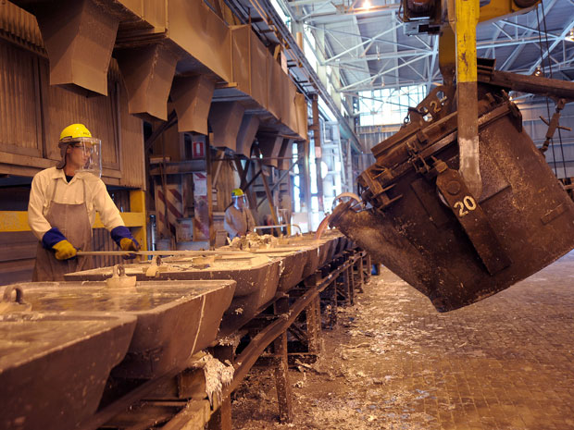
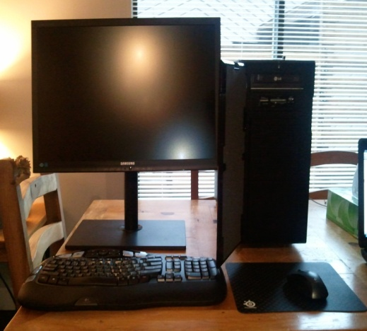
Our Favourite Thing:
A Personal Computer System
By:
Nathaniel Cortese & Lance Magnaye
Grade 7
Queen of All Saints School
Coquitlam, B.C., Canada

Slide 2
Personal Computer Systems
We were asked what our favourite object was at school or at home. Well, our Personal Computers at home topped the list!
Although we have a Windows personal computer, a Personal Computer (PC) can be a desktop computer, laptop, notebook, tablet or handheld PC.
Personal computer systems are an important part of everyone’s lives today. We use them for work, school, play and much more!
Most of us can not imagine what it would be like without a computer to allow us to do our schoolwork, games, and connect with the internet to Skype, Facebook, Twitter and Google.
The first desktop computers were built in the 1970’s mostly for science and business use. In the early 1980’s, companies like Commodore, Apple, IBM/Microsoft, Atari and others made personal computers popular for businesses and homes.

Slide 3
Personal Computer Systems
In 1977, there were about 48,000 PCs shipped, but by 2001 PC shipments reached approximately 125,000,000.
Between 1977 and 2002 ( 25 years) the number of PCs shipped worldwide over that time reached 1 billion.
Between 2003 and 2008 ( 5 years) there had been another 1 billion PCs shipped.
By 2008 there were 1 billion PCs being used and they expect by 2014 there will be 2 billion computers in use worldwide.
Computers are made up of many components and materials. These materials all start with the Earth as its source.
Without the hard work of the mining and production companies there would be no computers!

Slide 4
Materials
We were then asked what non-renewable resources were used to make the computer and where on Earth did they come from?
A personal computer system consists of thousands of components made of many different materials.
These materials are mined from the Earth and then processed and manufactured to finally end up as a part in your computer.
These materials come from all over the world.
Many of the computer materials can be found in Canada. Canada plays an important role in mining and exporting the raw materials to the factories throughout the world.

Slide 5
Materials Used
The following is a list of many of the materials used to make up a computer. As scientists and engineers continue to research new materials some of the list of materials will change. For example, they used to use Lead in electronic parts, but that has changed due to government regulations.
Silicon - Canada
Copper - Canada
Aluminum - Canada
Antimony - Canada
Neodymium
Dysprosium
Samarium
Terbium
Gallium
Zinc - Canada
Mica - Canada
Carbon Graphite
Cobalt - Canada
Indium - Canada
Iron - Canada
Lithium - Canada
Silver - Canada
Tin - Canada
Tantulum - Canada
Nickel - Canada
Chromium
Manganese
Plastic (Petroleum products) - Canada
Fiberglass Phenolic/Epoxy resin (silica sand, limestone, kaolin clay, fluorspar, colemanite, dolomite) - Canada

Slide 6
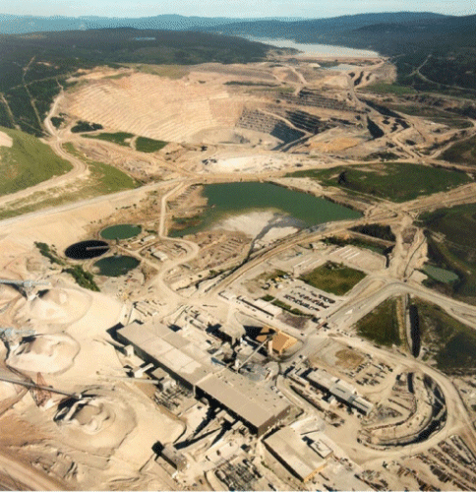
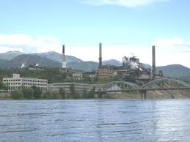
Canadian Mining
The Copper Mountain mine just outside of Princeton, B.C. was recently opened to export copper, silver and gold.
Highland Valley mine outside of Kamloops, B.C. is one of the largest copper mines in Canada.
The Creighton mine in Sudbury, Ontario is an example of a large nickel producer.
The Alouette mine in Quebec is one of the largest aluminum producers in the world.
Voisey Bay in Labrador, Newfoundland produces nickel, copper and cobalt.
The Newfoundland off-shore Hibernia oil fields and Alberta tar sands are examples of petroleum producers in Canada.

Slide 7
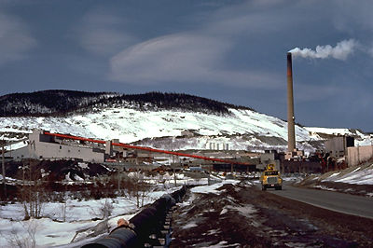
Canadian Mining
In Becancour, Quebec there are several large silicon producers making silicon products for solar cells and electronic semiconductor markets.
Indium is produced at Teck Cominco's Trail smelter in B.C., and the Kidd Creek operations at Timmins, Ontario produces copper and zinc .
Tanco Mine at Bernic Lake, Manitoba produces Tantalum and Cesium.
Canada Lithium Corporation in Quebec will start production in 2013.
Limestone is mined at Texada Island, B.C. by Lafarge Canada Corp.
The Bellekeno Mine and Mill in the Yukon is a silver and zinc producer.

Slide 8
Recycling
With millions of computers being replaced each year, businesses, mining companies and governments are working together to find ways to recycle the components.
Only about 15% of computers are recycled currently in the world.
SIMS Recycling Solutions Canada and Xstrata Canada (Noranda/Falconbridge) recycle lead, tin, aluminum, copper, cadmium, mercury, nickel, zinc, steel and plastics from computers.
Materials used in making computer systems are non-renewable so it is very important to be able to recycle computers.
Companies like Dell Inc. are banning the export of non-working computers to developing countries where they are being dumped.
Significant amounts of electricity and petroleum are used to process and manufacture the materials for computers which puts more strain on non-renewable resources.

Slide 9
Electronics Recycling Chart
The goal is to have at least 50% of electronics recycled by 2025.

Slide 10
WHERE on EARTH does this stuff come from?
Silicon – There are about 16 major producers in the world but the top ten are U.S.A., Brazil, Canada, China, France, Iceland, India, Kazakhstan, Macedonia, and Norway. About 25% of the world’s crust is silicon.
Copper – There are about 50 countries that produce Copper. The top 10 producers are Chile, U.S.A., Peru, China, Australia, Indonesia, Russia, Zambia, Canada and Poland. One of the world’s largest producing mines is Escondida Copper mine in Chile.
Aluminum – More than 40 countries produce Aluminum. The top 10 are China, Russia, Canada, Australia, U.S.A., Brazil, Jordan, UAE, Bahrain and Norway. The raw material for Aluminum is bauxite which is found mostly in South America, China, India, Australia and Russia.
Antimony – Only about a dozen countries produce Antimony with China, Peru, Russia, Ukraine, South Africa, Tajikistan, Bolivia, Australia, Canada, and Turkey. China produces more than 75% of the world’s antimony.
Neodymium – Neodymium is a rare earth metal. It is one of 17 rare earth metals. China, U.S.A., Brazil, India, Sri Lanka, and Australia are the producers. China makes about 95% of the world production.
Dysprosium – Dysprosium is a rare earth metal and is produced mostly in China. China produces about 97% of the world supply now. It is used in magnets.
Samarium – Samarium is also a rare earth metal mostly produced in China, U.S.A., and India.
Terbium – Rare earth metal produced in China, India, Brazil and Malaysia with China producing more than 90% of the world supply.
Gallium – Main producers are in China, Germany, Japan, and Ukraine. Gallium is used in many different electronic parts including LEDs, microchips and DVD players. Solid Gallium can melt in your hand as it has a low melting point.
Zinc – There are more than 40 countries that produce Zinc. The top 10 are China, Peru, Australia, U.S.A., Canada, India, Kazakhstan, Boliva, Mexico, and Ireland. New Brunswick has a few large Zinc mines.
Mica – Major producers are U.S.A., China, South Korea, Canada, Spain, Russia, Finland, and France. The largest single crystal found was in Lacey Mine Ontario and weighed 330 tons.
Carbon Graphite – China, South Korea, India, Brazil, U.S.A. and Mexico are large producers of Carbon silicates. Carbon
Cobalt – The top 10 producers are Congo, Russia, China, Zambia, Australia, Brazil, Canada, Cuba, Morocco, and Philippines. One of the biggest Cobalt mines in Canada is in Labrador.

Slide 11
WHERE on EARTH does this stuff come from?
Indium – Indium is used in LCDs and touchscreens. The top 10 producers of Indium are China, Korea, Japan, Canada, Belgium, Peru, Germany, Brazil, Italy, and the U.K.. The Teck Cominco plant in Trail, B.C. is a big producer of Indium.
Iron – Of over 40 countries that produce Iron, the top 10 are China, Australia, Brazil, India, Russia, Ukraine, South Africa, U.S.A., Canada, and Iran. It is the 4th most common element on earth.
Lithium – Argentina, Australia, Brazil, Canada, Chile, China, Portugal, Zimbabwe
Silver – Peru, Mexico, China, Australia, Chile, Poland, Russia, U.S.A., Canada, Kazakhstan
Tin – China, Indonesia, Peru, Bolivia, Brazil, Venezuela, Saudi Arabia, Canada, Iran, Iraq, Kuwait, UAE, Russia, Lybia, Nigeria
Tantulum – Produced in Australia, Brazil, Thailand, China and Canada. Tantalum is used in capacitors in electronic circuits.
Nickel – Top producers are Russia, Australia, Canada, Brazil, China, Columbia, Cuba, Dominican Republic, Indonesia, New Caledonia, and South Africa.
Chromium – The main producers are South Africa, Kazakhstan, India, Brazil, Finland, Iran, and Zimbabwe
Manganese – The biggest producers are China, South Africa, Australia, Brazil, Gabon, Kazakhstan, India, Ukraine, Ghana, and Mexico. Manganese is important for steel, aluminum and iron production.
Plastic (Petroleum Products) – Petroleum is used to make plastics for computers. The Arab League, Russia, Saudi Arabia, U.S.A., China, Iran, Canada, Mexico, UAE, Brazil, Kuwait are the largest of about 115 countries that produce petroleum to make plastics for electronic devices of all shapes and sizes.
Fiberglass – Used in making the electronic circuit boards used in all electronics products. The materials to make the fiberglass circuit boards are silica sand, limestone, kaolin clay, fluorspar, colemanite, and dolomite which come from many different countries. The largest producers of the fiberglass circuit boards are in China, Europe and the U.S.
Fluorspar – Produced in China, South Africa, and Mexico.
Silica – Produced in the U.S.A., United States, Norway, Russia, Brazil, and Canada.
Kaolin Clay – Main producers are Brazil, United Kingdom and the U.S.A.
Limestone – Produced in the United States, Canada, Mexico, Belgium, Brazil, China, France, Germany, Italy, Japan, Poland, Romania, and the United Kingdom.
Dolomite – Largest producers are U.S.A., Canada, Switzerland, Spain and in Mexico.
Colemanite – Produced in USA, Chile and Turkey.

Slide 12
Information Sources
Global PC Shipments grew 3.1% in Q4 2010 – Gartner Study
http://www.gartner.com/it/page.jsp?id=1519417
Global PC Shipments grew 13.8% in 2010 – Gartner Study
http://www.gmanetwork.com/news/story/210464/scitech/global-pc-shipments-grew-13-8-percent-in-2010-gartner-study
Computers reach one billion mark
http://www.gartner.com/it/page.jsp?id=703807
Computers sold in the World
Computers Sold in the World : http://www.worldometers.info/computers/
Mining in Canada
http://www.thecanadianencyclopedia.com/articles/mining
Timminco Silicon Producers - Bécancour Quebec
http://www.timminco.com/
REC Silicon Producers - Bécancour Quebec
http://www.siteselection.com/issues/2008/nov/North-American/
Canada Mining
http://www.nationsencyclopedia.com/Americas/Canada-MINING.html#b
Texada Quarry, B.C. – Lafarge Canada - Limestone
http://www.rocktoroad.com/content/view/958/38/
Bellekeno – Yukon – Silver and Zinc mine
http://www.mineweb.co.za/mineweb/view/mineweb/en/page32?oid=110182&sn=Detail&pid=102055
Recycling of e-waste
http://www.globe-net.com/articles/2011/december/29/e-waste-crisis-being-mitigated-by-electronics-recycling-and-reuse/
SIMS Recycling Solutions – Xstrata (Noranda/Falconbridge) Recycling
http://www.accn.ca/index.php?ci_id=2897&la_id=1
Copper Mountain B.C. Project
http://www.mining-technology.com/projects/copper-montain/

