Slide 1
Hi!
I am Xavier, and I love car racing!

Slide 2
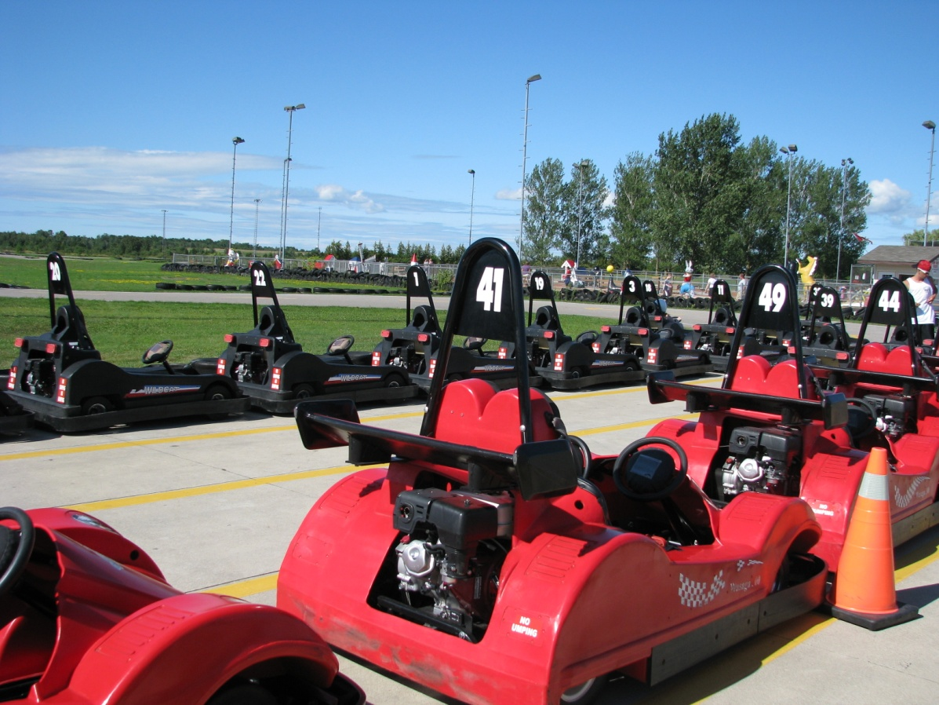
During summer I love to go to the track and do a few laps.

Slide 3
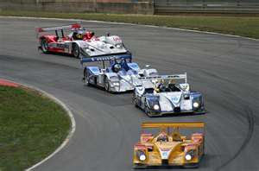
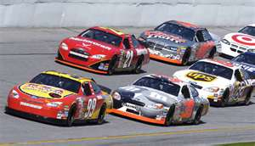
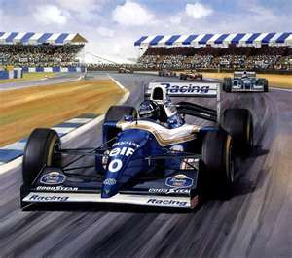
... And of course my favourite sport is car racing!

Slide 4
Car racing unites people all over the world
Daytona 500
Montreal Grand Prix
Grand Prix of Japan
Australian Grand Prix
Brazilian Grand Prix

Slide 5
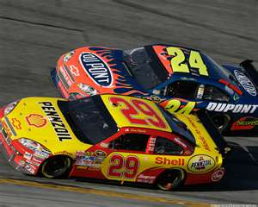
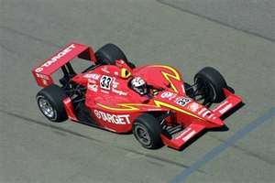
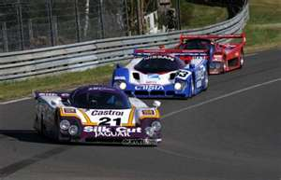
Car racing unites people all over the world
Nascar Racing
Indy Racing
Rally Racing
LeMans Racing Series

Slide 6
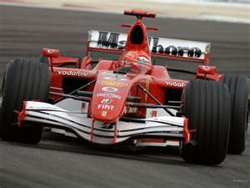
However my favourite series is the Formula 1
This is a formula 1 car!
A Hi Tech pot-pourri of non-renewable resources on 4 wheels

Slide 7
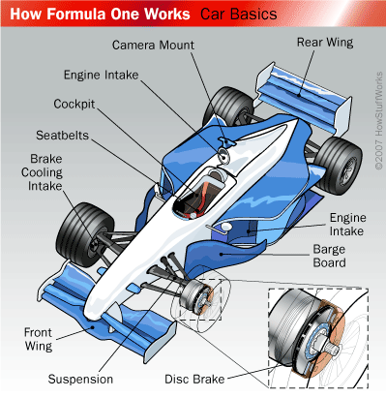
Lets take a closer look to see Where on Earth can we find each components of a F1 car.

Slide 8
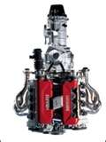
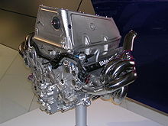
The Engine & The Transmission
The FIA banned teams to use exotic materials in engine and transmission construction. Today teams can only use aluminium and iron alloys for the production of the pistons, cylinders, gears, and crank shanks.

Slide 9
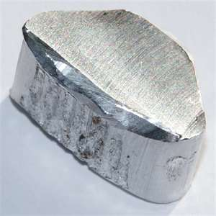
Aluminium (Al)
The properties that make aluminium one of the most desired metals are:
Light weight, strong, nonmagnetic and nontoxic
Conducts heat and electricity
Reflects heat and light
Strong but easily workable
retains its strength under extreme cold without becoming brittle
The third most plentiful element
in the earth's crust, comprising
8% of the planet's soil and rocks

Slide 10
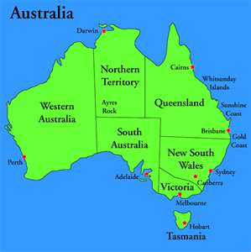
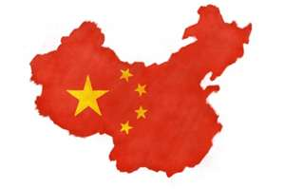
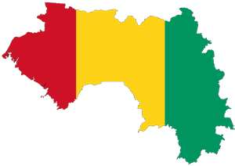
Where Do We Find Aluminium?
Never found as a pure metal but as a compound.
Its main source is Bauxite.
Other countries we find Bauxite
China
Brazil
1/3 of earth’s Bauxite
Source is found in Australia.
Jamaica
Guinea

Slide 11
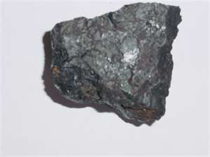
Iron (Fe)
Iron forms much of Earth's outer and inner core.
It is the fourth most common element in the Earth’s crust.

Slide 12
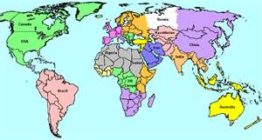
Where Do We Find Iron?
Canada
Russia
China
United-States
Malaysia
Brazil
Australia
...and many other countries around the world

Slide 13
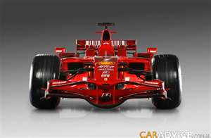
The Chassis
F1 uses carbon composites to build its chassis. The reason is because carbon composite is:
super lightweight.
super strong.
super stiff.
easily molded into all kinds of different shapes.

Slide 14
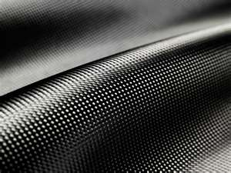
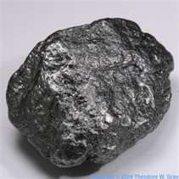
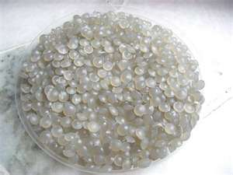
What is Carbon Composite
Carbon fiber is, exactly what it sounds like – fiber made of carbon. But, these fibers are only a base. What is commonly referred to as carbon fiber is a material consisting of very thin filaments of carbon atoms. When bound together with plastic polymer resin by heat, pressure or in a vacuum a composite material is formed that is both strong and lightweight.
Carbon (C): Carbon is a naturally abundant non-metallic element which forms the basis of most living organisms.
Carbon
Plastic polymer
Carbon fibre

Slide 15
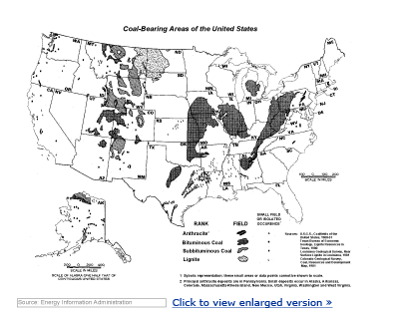
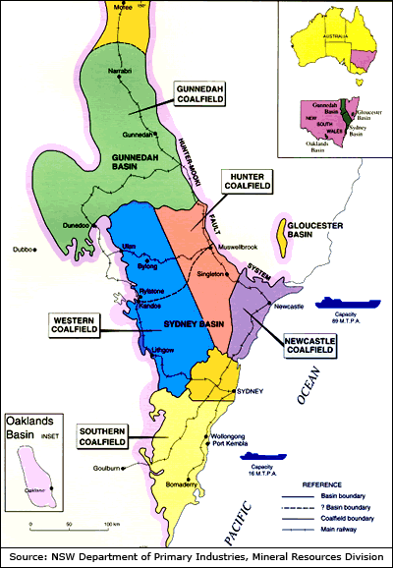
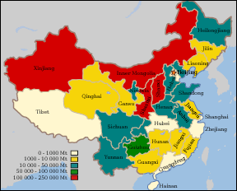
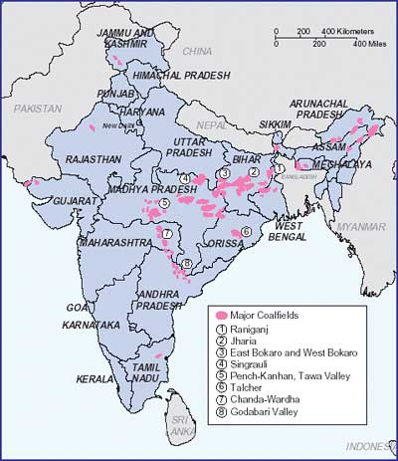
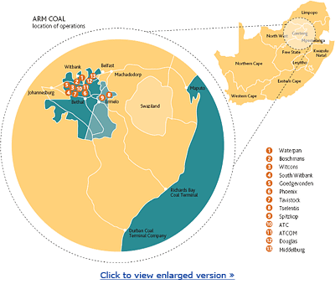
Where do we Find Carbon?
Top 5 countries mining carbon/coal in 2007:
USA
China
India
Australia
South Africa

Slide 16
What is Carbon Composite
Plastic polymer: Although the term polymer is sometimes taken to refer to plastics, it actually encompasses a large class of compounds comprising both natural and synthetic materials with a wide variety of properties.
Therefore, to produce plastic polymer you need petroleum.
Petroleum is a mixture of different compounds and is rarely used as a whole. Is one of the non-renewable resources most convoyed by humans. After it's distillation in a refinery it gives a wide range of products, mainly fuels( gasoline, diesel, kerosene, etc. ). It's other derivatives can be used to produce products such as wax, lubricants, paraffin, asphalt, plastic etc.

Slide 17
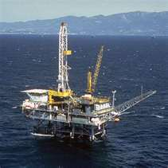
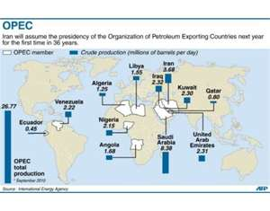
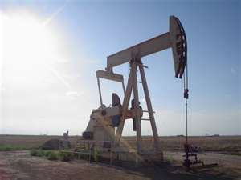
Where Do We Find Petroleum
Offshore drilling:
Gulf of Mexico (US)
Canada
Baltic Sea
Norwegian Sea
OPEC Members Organization of the Petroleum Exporting Countries
Iran,
Iraq,
Kuwait,
Venezuela,
Saudi Arabia,
Qatar
Libya

Slide 18
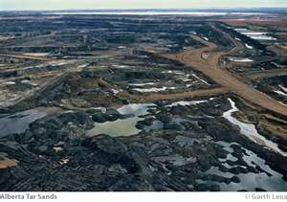
... Other Countries That Drill For Petroleum
Russia
Nigeria
Texas USA
Alberta Canada

Slide 19
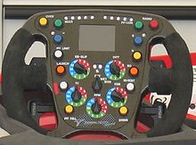
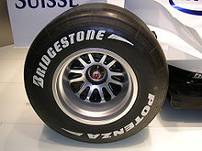
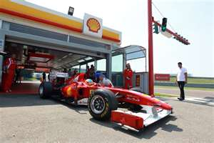
In a F1 Car, Petroleum is Also Needed to Build ...
The steering wheel
... Less not we forget the fuel
The tires

Slide 20
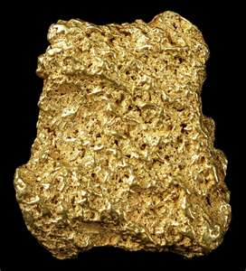
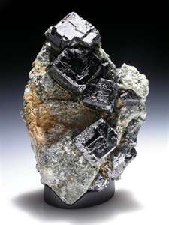
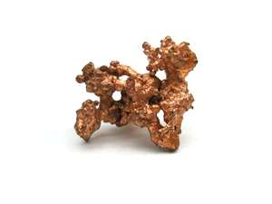
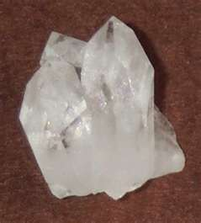
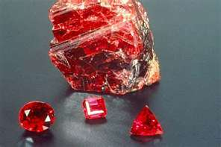
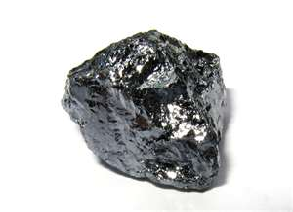
Finally ... The electronic components
Which are composed of wires and alloys made of...
Gold
Copper
Perovskite
Wycheproofite
Quartz
Silicium
Ruby

Slide 21
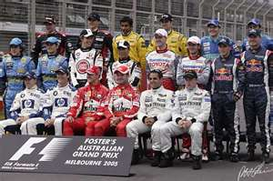
So to Summarize
Without Non-Renewable Resources All That Would Be Left is ...
The drivers!

Slide 22
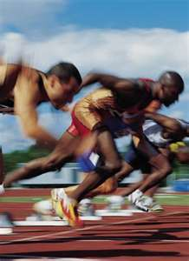
... And F1 racing would resemble this...
But without the shoes ..............

Slide 23
Information:
http://auto.howstuffworks.com/auto-racing/motorsports/formula-one2.htm
http://www.madehow.com/Volume-5/Aluminum.html
http://wiki.answers.com/Q/Where_is_aluminum_found
http://en.wikipedia.org/wiki/Iron_ore#Available_world_iron_ore_resources
http://life123.com/career-money/commodities-2/iron-ore/where-is-iron-ore-found.shtml
http://www.f1technical.net/articles/66
http://formula1.about.com/od/car1/a/carbon_fiber.htm
http://www.wisegeek.com/what-is-carbon.htm
http://coal.infomine.com/countries/
http://en.wikipedia.org/wiki/Polymer
http://www.opec.org/opec_web/en/about_us/25.htm
http://en.wikipedia.org/wiki/Formula_One_car
http://museumvictoria.com.au/melbournemuseum/discoverycentre/dynamic-earth/videos/minerals-with-high-tech-applications-/

Slide 24
Images:
http://www.google.ca/imghp?hl=en&tab=wi
http://images.search.yahoo.com/images

