Slide 1
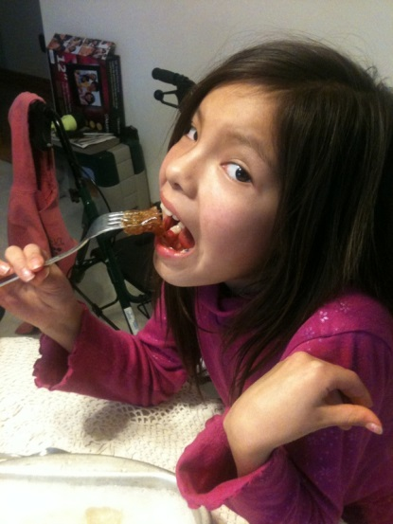
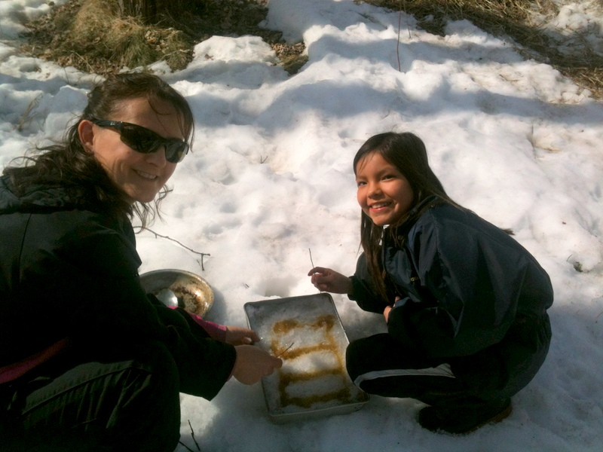
Mother Nature’s Golden Treasure

Slide 2
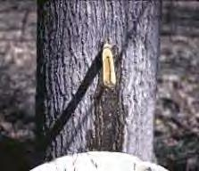
HISTORY OF Maple Syrup
Native Americans were the first to discover 'sinzibuckwud', this word means 'drawn from wood‘ we now call it Maple syrup
Making maple syrup goes back as far as late 1500’s, they would put gash in the tree and collected the sap in a wooden trough.
Early settlers, both French and English, started to use an auger to make a smaller wound or taphole. They made spouts by pushing the pith out of small stems of sumac or elder to direct the water into a container.
In the 1800’s they started making metal spouts.

Slide 3
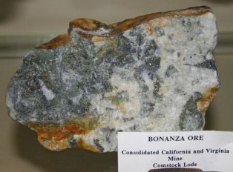
Metals
Metal is found inside of rocks in mines. These rocks are called ore. In order to separate the other minerals in the rock from the metal, the ore is heated to really hot temperatures in a process called smelting
Around 75% of the elements in the periodic table are metals. Metals are known for conducting electricity and heat well.
Many metals are strong, shiny, and hard. They are also often malleable, meaning they can be shaped without breaking or cracking.
Metals are strong and are useful for making tools
Metals are found all over the world

Slide 4
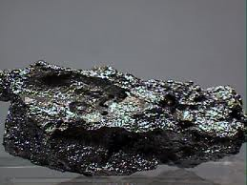
The Drill
The Drill Bit is made of Titanium-Ti
It’s usually Silver, Gold or Gray. The hardness of the titanium is 4. The magnetism is weak and Titanium has a little attraction to a magnet.
It is the ninth-most abundant element in the Earth’s crust and the seventh-most abundant metal.
It is present in most Igneous Rocks.
Top producing countries:
Australia, South Africa, Canada, China,
Norway, India, Ukraine, Vietnam

Slide 5
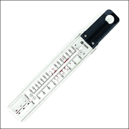
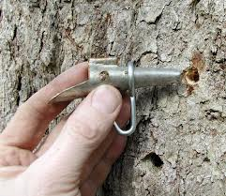
Spouts and Thermometer Stainless Steel
Stainless steel is made of iron with around 12% Chromium
Iron – Fe when iron and oxygen react in the presence of water or moisture, rust (iron oxide) is formed
Chromium – Cr is a silver-gray metal that shines brightly when polished
Other alloying elements are added to make Stainless Steel These include metals such as: - Nickel -Molybdenum -Titanium -Copper
Non-metal additions are also made, the main ones being: -Carbon -Nitrogen
Some top producing Countries: Luxembourg, China, South Korea and Japan to name a few

Slide 6
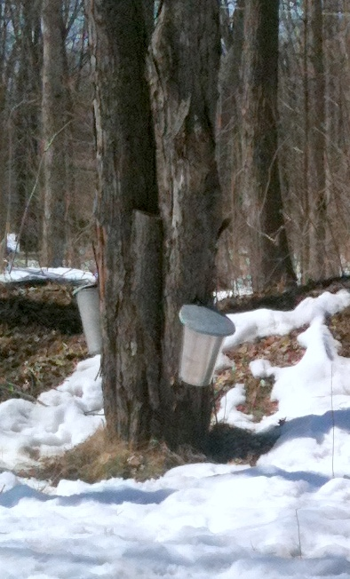
Buckets Aluminum-Al
Aluminum buckets are silver when it’s freshly made. Most cans in the U.S.A & Canada are made out of recycled aluminum.
Aluminum is strong and a good conductor of electricity. It’s durable, unaffected by water and gas also it’s light in weight.
Aluminum is the most common metal found in the Earth's crust
Some top producing countries: China, Russia, Canada, USA, Australia

Slide 7
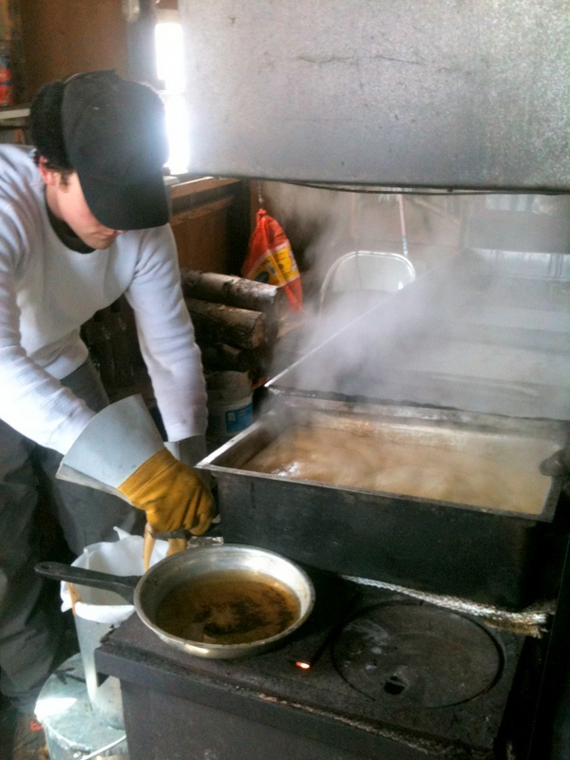
Wood Stove Heavy plate steel
Steel is a combination of metals that is created from a mixture of metals, mostly iron. There are many different types of steel including stainless steel, galvanized steel and carbon steel.
Steel is commonly used to make a number of products including knives, machines, train rails, cars, motors and stoves.
Top producing countries: China, Japan, Russia, USA, India

Slide 8
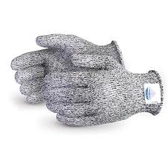
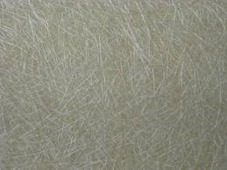
Fiberglass Gloves
Fiberglass gloves are made out of extremely little fine fiber of glass.
It was invented in 1938 as a material to be used as insulation.
It has no true melting point but softens up to 1200°C this is one reason why it makes a perfect material to make these gloves.

Slide 9
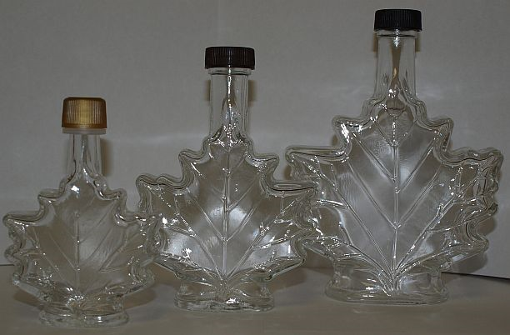
Bottling Syrup Glass
Is a form of matter
Glass is a made by melting a mixture of sand and other minerals
like silica (sand), potassium or soda, lime to name a few.
While it is still a hot liquid, glass can be manipulated by glass blowers to form bottles and other decorations. They blow air into the liquid glass through a long pipe and shapes the glass.
Top manufacturing countries: France, Japan, USA, Germany

Slide 10
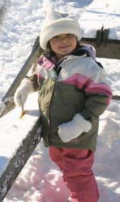
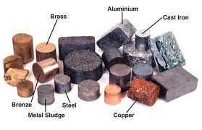
Renewable
and
Non-renewable resources are both important now and in our future
Using them both wisely will enhance our lives

Slide 11
References
http://gourmet.lovetoknow.com/How_to_Make_Maple_Sugar
http://gourmet.lovetoknow.com/How_to_Make_Maple_Sugar
http://www.turtletrack.org/Issues00/Co03112000/CO_03112000_Maple.htm
http://www.funkidslive.com/features/geology-rocks/geology-rocks-rock-around-our-homes/
http://library.thinkquest.org/05aug/00461/titanium.htm
http://www.stevesauter.com/Maple_Syrup_Lesson_Plan.html
http://www.ducksters.com/science/metals.php
http://www.tapmytrees.com/syth.html
http://encyclopedia.kids.net.au/page/fi/Fiberglass
http://www.kidcyber.com.au/topics/glass.htm
http://en.wikipedia.org/wiki/List_of_countries_by_aluminium_production
http://top5ofanything.com/index.php?h=b289de68

