Slide 1
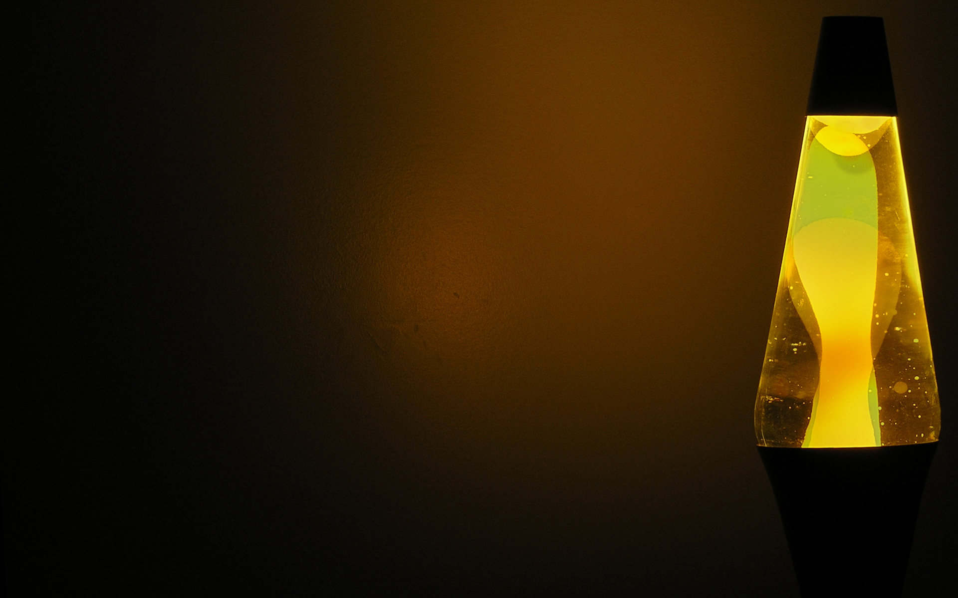
2013 Grade 9 WHERE Challenge Project
The Lava Lamp
By: Angela Ashley

Slide 2
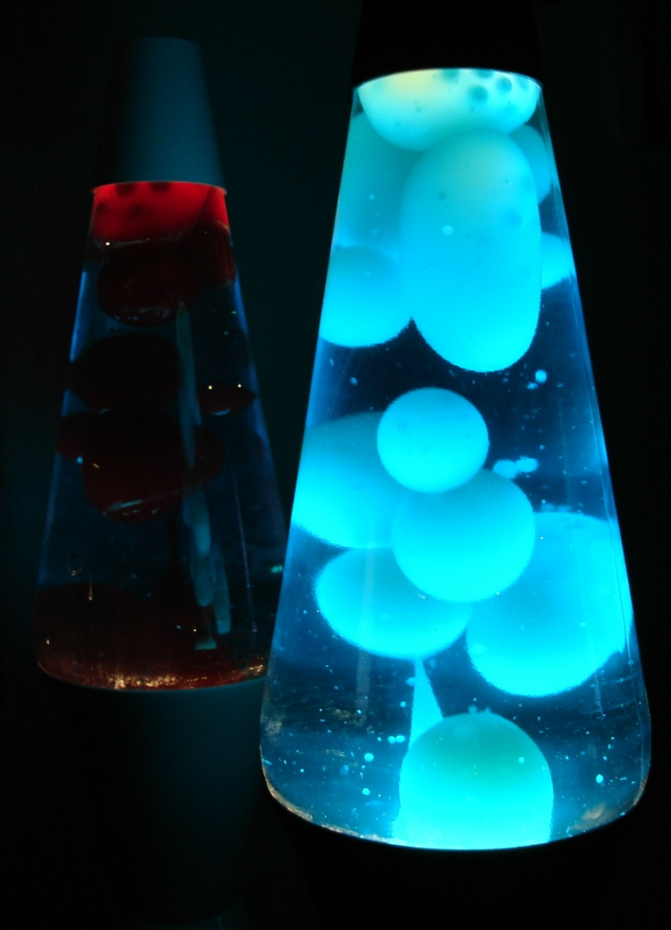
The Lava Lamp
The Lava Lamp, a glowing container of pure fascination for any young individual’s dorm room in the 60s and 70s. The glowing masterpiece was created by one, Craven Walker, who first got the idea from an early version in an English pub in the 1940s. The first round was put on display in the 1960s as “Astro Lamps”, where two American entrepreneurs bought the rights to manufacture them in North America. The name was changed to the popular “Lava Lamp” and today, is selling more than 400,000 lamps to stores around the world.

Slide 3
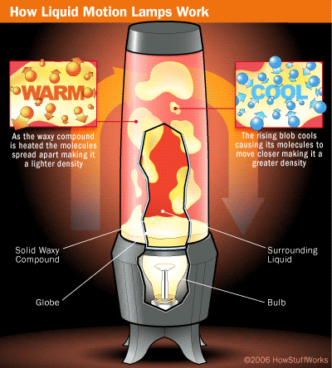
Materials and Parts of the Lamp
Glass Chamber (Quartz Sand)
Wax compound in Watery Solution (Mineral Oil)
Metallic Coil in Base (Copper)
Base (Aluminum)
Light bulb Energy Source, Glass (Quartz Sand)
Here are just a few of the basic components of a Lava Lamp, that will be discussed further on!

Slide 4
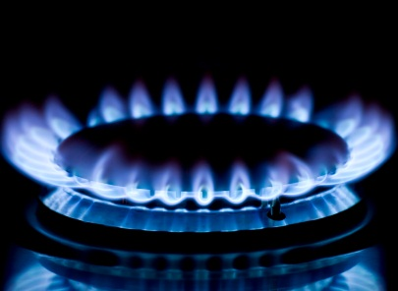
Wait! Aren’t we missing something?
Yes! We are! These resources used to make the lava lamp are NON-RENEWABLE! Meaning these resources must be mined, quarried, or pumped out of the Earth to be received. They are natural substances that we use and consume faster than can be naturally sustained and replaced!
Natural Gas is an example of a non-renewable resource; A fossil fuel!
Whoa! Crazy man!
Names Bobby Buoyant! I’m here to take you on a sick journey into the soul man, the soul of a Lava Lamp!

Slide 5
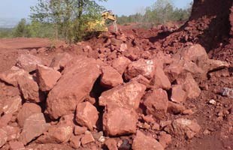
Aluminum
The first stop on our journey is the base of our psychedelic lamp, composed of Aluminum. Did you know Aluminum’s natural state in nature is in fact not a metal? It’s actually a composition of Bauxite Ore which is 45-60% Aluminum Oxide, mined frequently from Australia or Guinea. The Bauxite is sent through a refining process (Bayer process) to obtain Alumina, and enters a electrolysis process that smelts the Alumina with electrolyte, separating the Alumina into molten Aluminum metal. Eventually crafted into our sick base!
This is the Earth’s third most plentiful
element (8%) and a recyclable product in things like cans. However, its Bauxite Ore content (as most Ores) takes thousands of years to produce more. That means Peace out Aluminum!

Slide 6
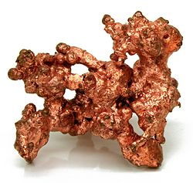
Copper
Our next groovy stop on the lava soul ride is Copper! To create our crazy lava, the high thermal and electrical conductivity of Copper helps out in the base coil and electrical wires. This metallic element is not commonly found pure in nature, but mixed with other substances like Iron to create a Copper Ore. The Ore (most commonly a Sulfide called Chalcopyrite) is mined mostly in the USA, Utah, Chile, and Peru as well as other places. It is concentrated, smelted, refined (to remove further impurities), and casted into long coils for our wires and base coils!
Did you know…
Copper is a hugely recycled material! In North America, nearly half of all Copper used is from recycled material! But it is still a non-renewable resource mined from the Earth over thousands of years, quickly depleting! Bummer!

Slide 7
Hey Check This! Physics!!
Our Lava Lamp actually uses Archimedes Principle to create Lava! This states that the buoyant force on a submerged object is equal to the weight of the fluid that is displaced by the object! Meaning, as the light bulb heats up our copper coil, the wax at the bottom is heated and expanded to a lighter density (makes it float). As it cools at the top away from the heat it contracts to a greater density (sinks), repeating in a continuous cycle! Wicked!!

Slide 8
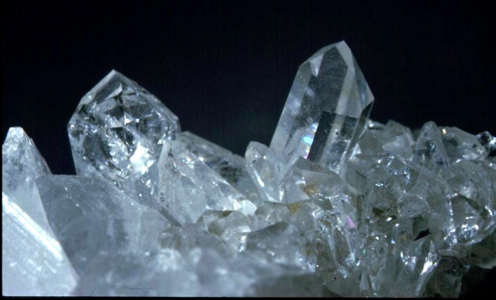
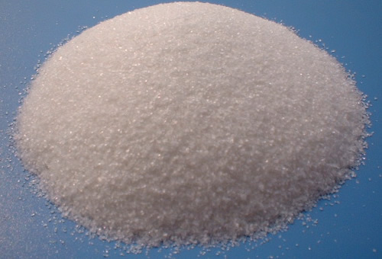
Quartz
Hey man! We’re almost to end of our journey! Far out! Our next ingredient to our Lava Lamp is Quartz Sand (Silica Sand). Quartz (the main substance) is the second most abundant mineral in the Earth’s crust which combined with other substances like Limestone, Soda Ash, and Gypsum form Glass. Quartz can be found in acid igneous, metamorphic, and sedimentary rocks found in Arkansas and Brazil (pretty much anywhere), which may break down, forming Quartz sand produced commonly in India and Australia. The substances are melted, refined, shaped, and cooled in the proper form creating our hip glass chambers! Right on!
Did you know…
People used to think Quartz crystals were fragments of fallen stars!
Dig this, although seemingly abundant, Quartz is still non-renewable. It takes centuries For the earth to produce more!

Slide 9
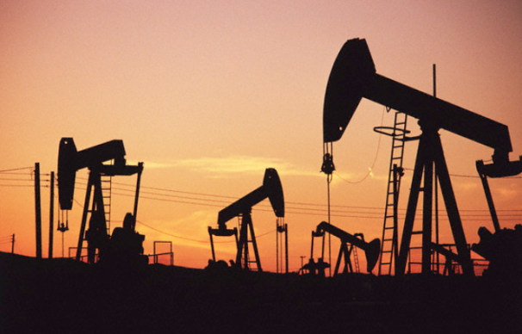
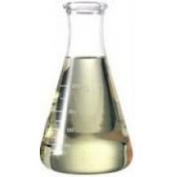
Mineral Oil
Fun Fact Man: Mineral Oil (or Liquid Petroleum) is actually a liquid by-product of the distillation of Petroleum, to provide gasoline and other similar products from Crude Oil. Since Petroleum is a fossil fuel from plants and animals millions of years ago, Mineral Oil (used for part of the watery substance in some of our lamps) is technically non-renewable!
Places such as the USA, Canada, and Saudi Arabia are huge producers of crude oil. Up to 200 million barrels annually!
Liquid Petroleum
(Mineral Oil)

Slide 10
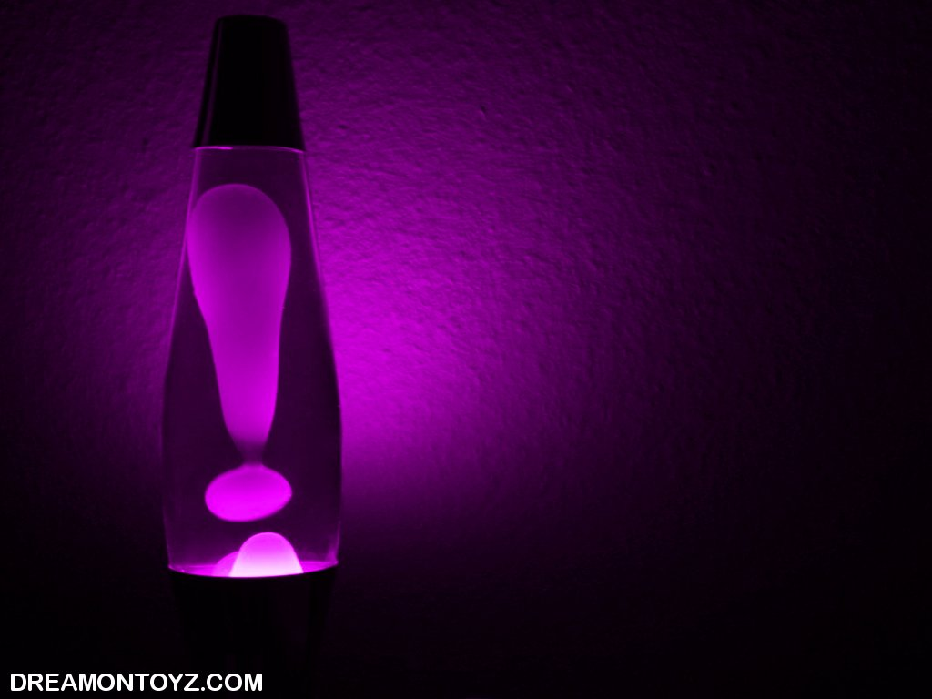
And We’re Done!!!
Right on! More power to you my friends! You have successfully completed your journey into the soul of a Lava Lamp! Now you know the righteous non-renewable resources it can take to make something as wicked as your very own Lava Lamp! But don’t be so quick to split with this scientific contraption! All those resources used to make such a wondrous thing can take centuries to replace, almost as long as my van!
JUST KIDDING ABOUT THE VAN!
Peace Out!

Slide 11
Bibliography
A big thank you to these resources! …
http://earthsciencescanada.com/where/#
http://www.enotes.com/lava-lamp-reference/lava-lamp
http://www.ehow.com/about_6690585_lava-lamps-made-out-of_.html
http://answers.yahoo.com/question/index?qid=20081114205339AACQ51m
http://en.wikipedia.org/wiki/Lava_lamp
http://inventors.about.com/od/lstartinventions/a/lava_lamp.htm
http://greenliving.lovetoknow.com/Non_Renewable_Resources
http://en.wikipedia.org/wiki/Mineral_oil
http://www.wisegeek.org/what-is-mineral-oil.htm
http://www.globalspec.com/learnmore/materials_chemicals_adhesives/industrial_oils_fluids/petroleum_mineral_oil_products
http://www.quoteoil.com/oil-imports.html
http://www.venocoinc.com/community/learning/primarypetrol.pdf
http://www.youtube.com/watch?v=Z8ErqynlvtY http://www.youtube.com/watch?v=DL3Ez9bxMTo
http://www.youtube.com/watch?v=4j1hafqSyG0
http://school.eb.com/eb :
http://school.eb.com/eb/search?query=where+does+quartz+sand+come+from%3F&ct=eb&fuzzy=true&autobounce=true
http://school.eb.com/eb/article-9062182?query=where%20does%20quartz%20sand%20come%20from%3F&ct=eb
http://school.eb.com/eb/article-9065435?query=where%20does%20quartz%20sand%20come%20from%3F&ct=eb
http://go.grolier.com/
http://www.juniorgeo.co.uk/index.php?category=4&sub_category=9#quartz
http://nature.berkeley.edu/classes/eps2//wisc/Lect13.html
http://www.gemstoneeducation.com/Quartz_2.htm
http://www.galleries.com/Quartz#p
http://www.indexmundi.com/en/commodities/minerals/silica/silica_t11.html
http://www.chemicool.com/elements/aluminum.html
http://en.wikipedia.org/wiki/Aluminium
http://www.aluminumfoils.com/foil-production/aluminum-made.html
http://www.aluminum.org/Content/NavigationMenu/TheIndustry/Alumina/default.htm
http://www.madehow.com/Volume-5/Aluminum.html
http://www.youtube.com/watch?v=fa6KEwWY9HU
http://wiki.answers.com/Q/Where_does_aluminum_come_from
http://aluminium.org.au/FAQRetrieve.aspx?ID=42259
http://www.mii.org/minerals/photoal.html
http://library.thinkquest.org/05aug/00461/bauxite.htm
http://en.wikipedia.org/wiki/Copper
http://www.elementalmatter.info/element-copper.htm
http://www.metalreference.com/INFO_Copper_Alloy_.html
http://www.nwma.org/education/copper_facts.htm
http://answers.yahoo.com/question/index?qid=20071011153032AA6aYTE
http://education.jlab.org/itselemental/ele029.html
http://www.madehow.com/Volume-4/Copper.html
http://www.whyzz.com/where-does-copper-come-from
http://users.wpi.edu/~agilday/geology/where%20does%20copper.htm
http://www.copper.org/education/Kids/copperandkids_wheredoescopper.html
http://school.eb.com/eb/article-9026194?query=Copper&ct=null
http://www.grc.nasa.gov/WWW/k-12/WindTunnel/Activities/buoy_Archimedes.html

